Slide 1

Workshop on Android Application Development
Dr. Manoj Kumar M V
Assoc. Professor,
Department of Information Science and Engineering,
Nitte Meenakshi Institute of Technology, Bengaluru
http://www.reactopage.com/manoj
manojmv24@gmail.com, manoj.kumar@nmit.ac.in

Slide 2

Workshop on Hybrid Application Development
Dr. Manoj Kumar M V
Assoc. Professor,
Department of Information Science and Engineering,
Nitte Meenakshi Institute of Technology, Bengaluru
http://www.reactopage.com/manoj
manojmv24@gmail.com, manoj.kumar@nmit.ac.in

Slide 3
What is this about?
Android
iOS
Web
Desktop apps

Slide 4

Guess it !
Q1: How many different languages android is available in?
40
50
100+
74
Correct answer is 100+
Ref: https://en.wikipedia.org/wiki/Google_Play

Slide 5
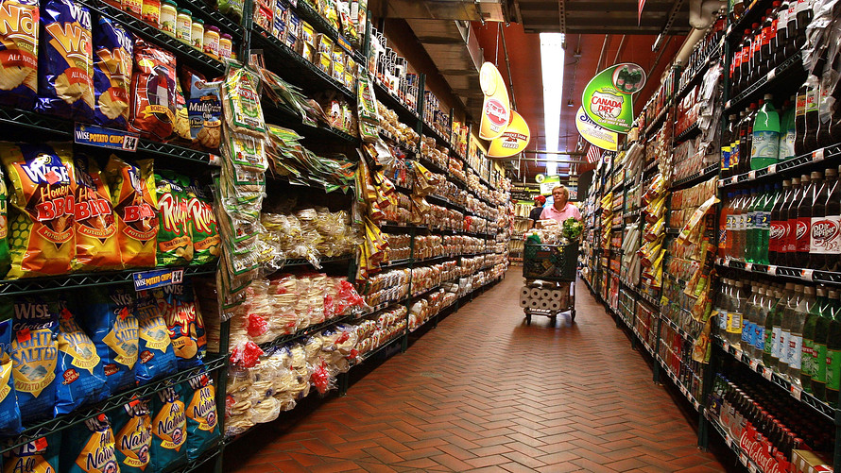
Guess it !
Q2: How many applications are available in Google Play for download?
2.7 million
1.3 million
2.0 million
2.5 million
Correct answer is 3.5 million
Ref: https://en.wikipedia.org/wiki/Google_Play

Slide 6

Guess it !
Q4: How many apps are downloaded from Google play so far?
117 Billion
121 Billion
117 Million
121 Million
Correct answer is 117 Billion
Ref: https://en.wikipedia.org/wiki/Google_Play

Slide 7
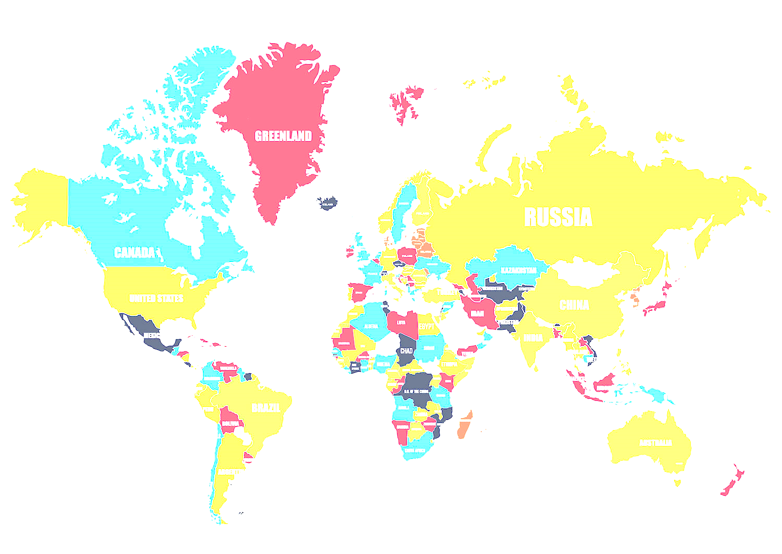
Guess it !
Q3: Users in how many countries can purchase apps through Google play?
145
150
155
130
Correct answer is 145
Ref: https://en.wikipedia.org/wiki/Google_Play

Slide 8
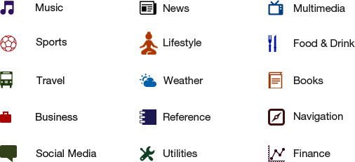

Slide 9
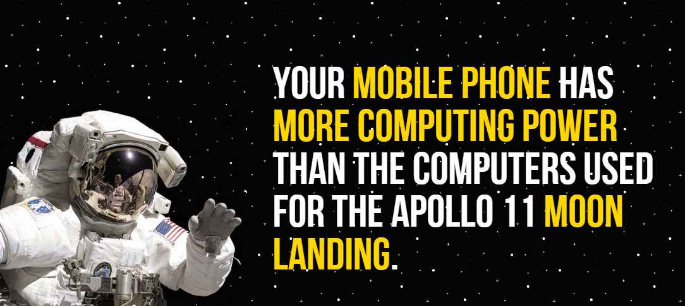

Slide 10
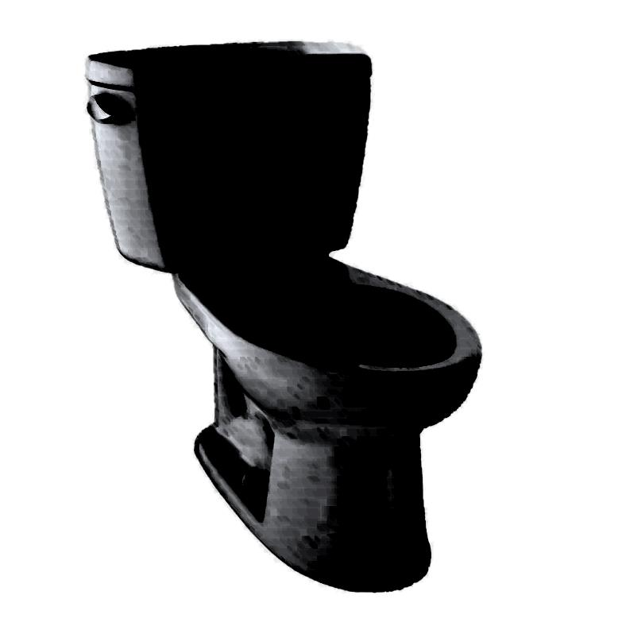
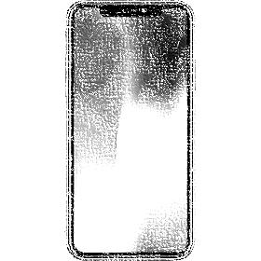
Six of the world's seven billion people have mobile phones - but only 4.5 billion have a toilet, according to a U.N. report.
http://www.dailymail.co.uk/news/article-2297508/Six-world-s-seven-billion-people-mobile-phones--4-5billion-toilet-says-UN-report.html

Slide 11
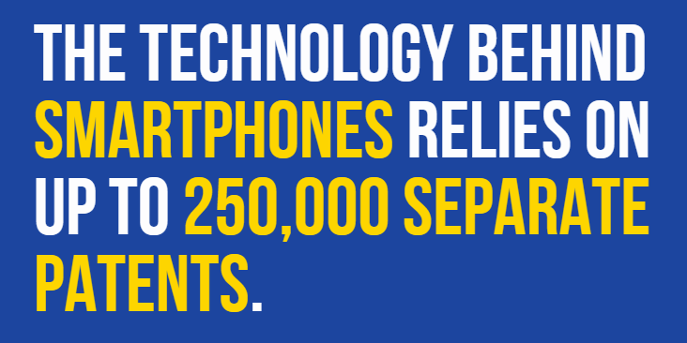

Slide 12


Slide 13

Basic Applications Types

Slide 14
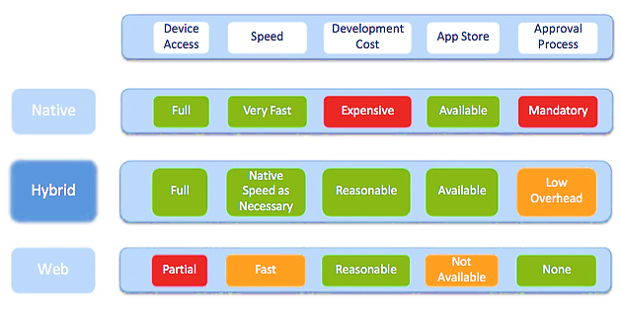

Slide 15
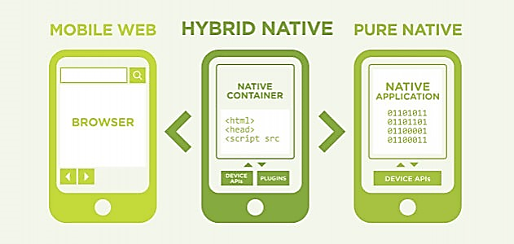

Slide 16
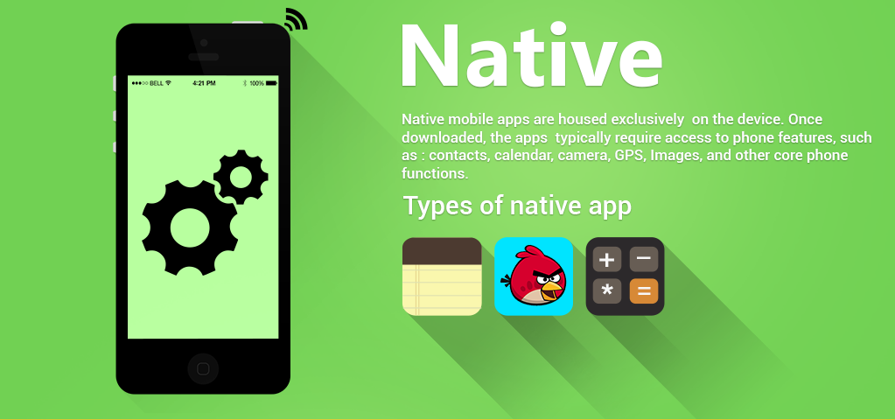

Slide 17
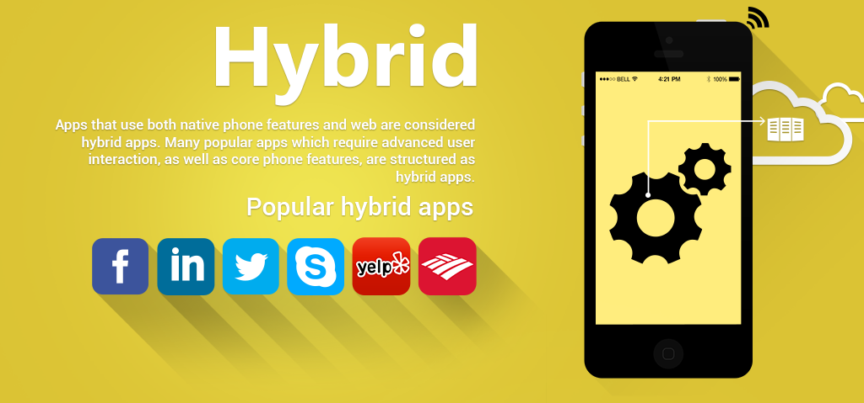

Slide 18
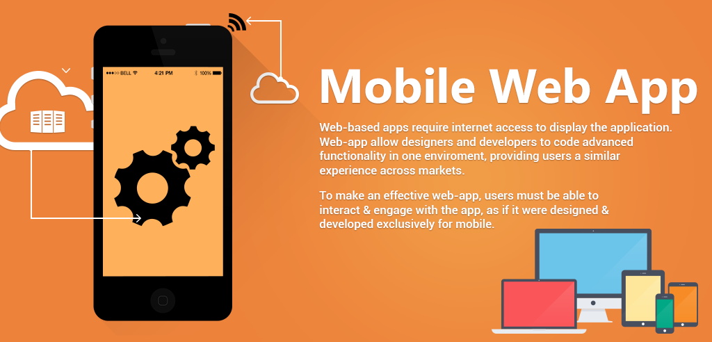

Slide 19

Alternative platforms

Slide 20


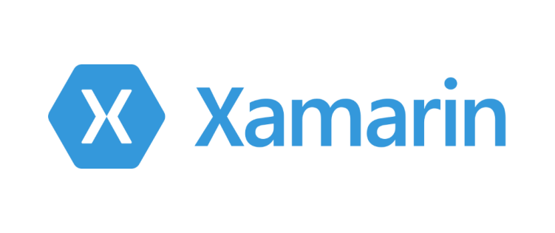


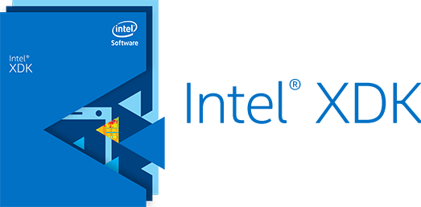




Slide 21


Notes:
PhoneGap is a software development framework by Adobe System, which is used to develop mobile applications.
To develop apps using PhoneGap, the developer does not require to have knowledge of mobile programming language but only web-development languages like, HTML, CSS, and JScript.
PhoneGap produces apps for all popular mobile OS platforms such as iOS, Android, BlackBerry, and Windows Mobile OS etc.

Slide 22
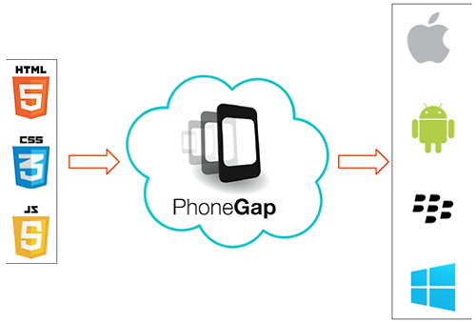

Slide 23
build for
people
loved ones
teachers
small business
artists
living room
love
the road
future
environment
wearables
students
watches
manufacturers
gamers
safety
kids
fitness
yourself
self expression
communities
phones
large screens
everyone
small screens
friends
laptops
tomorrow
tablets
fun
cars
TVs
families
offices
mindfulness
shopping
today
business
good
society
enterprise
augmented realities

Slide 24
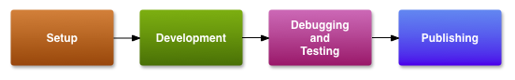
Publishing Overview

Slide 25
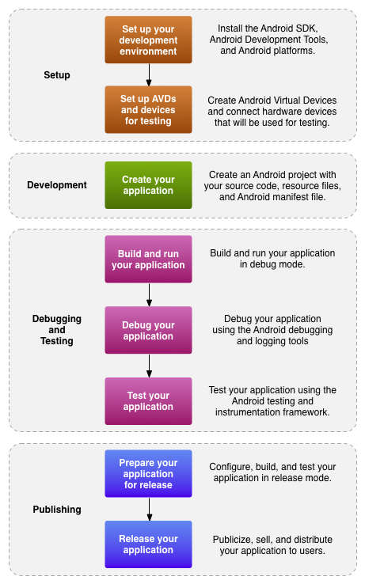
Development Lifecycle

Slide 26


Slide 27
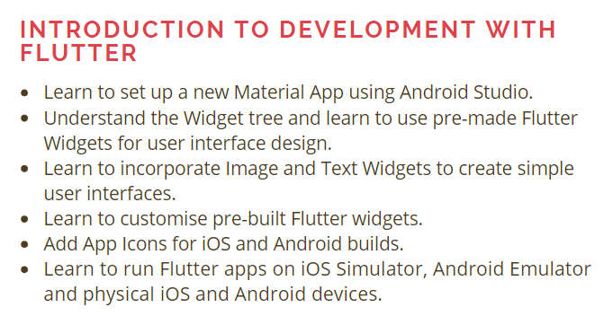

Slide 28
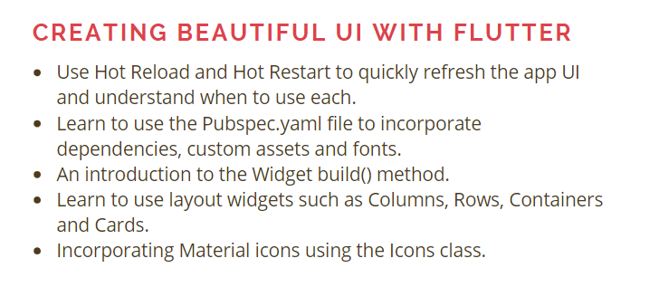

Slide 29
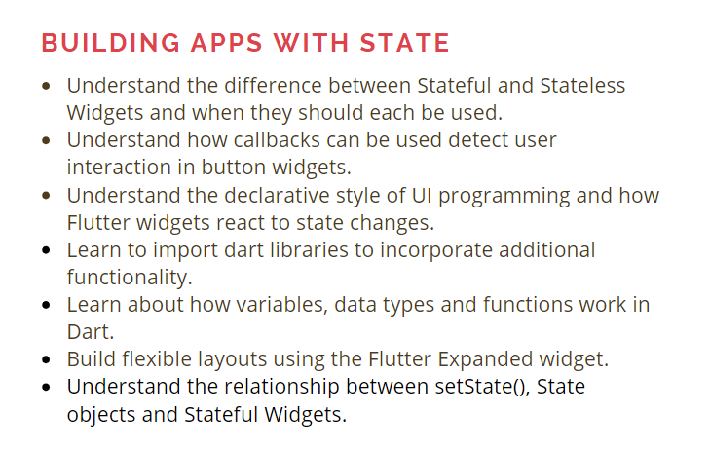

Slide 30
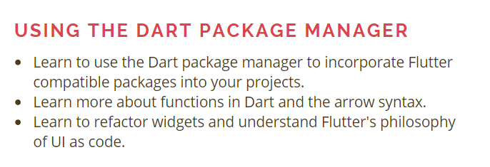
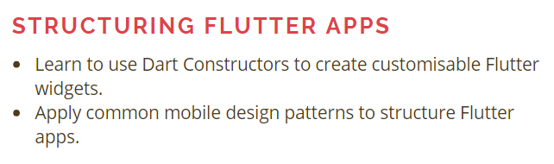

Slide 31
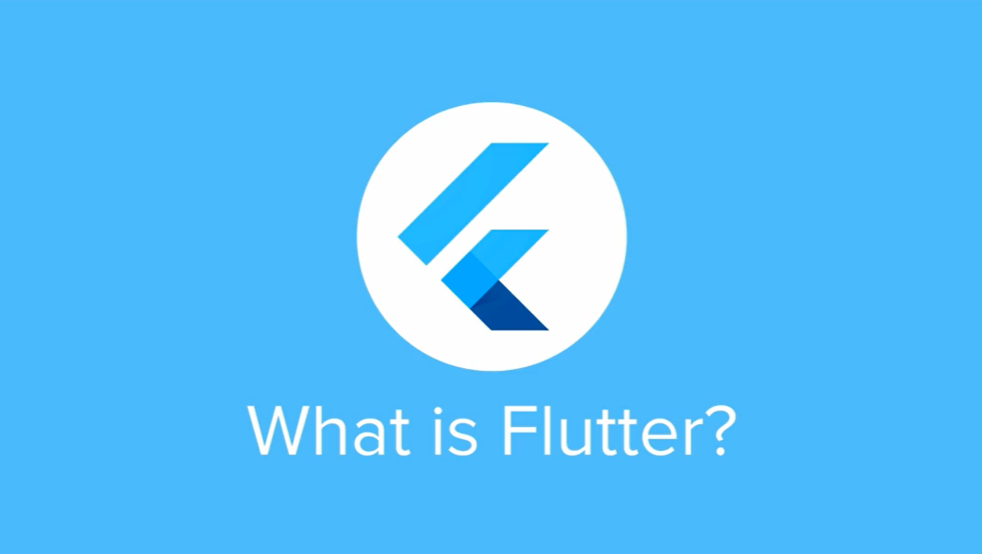

Slide 32


Slide 33


Slide 34
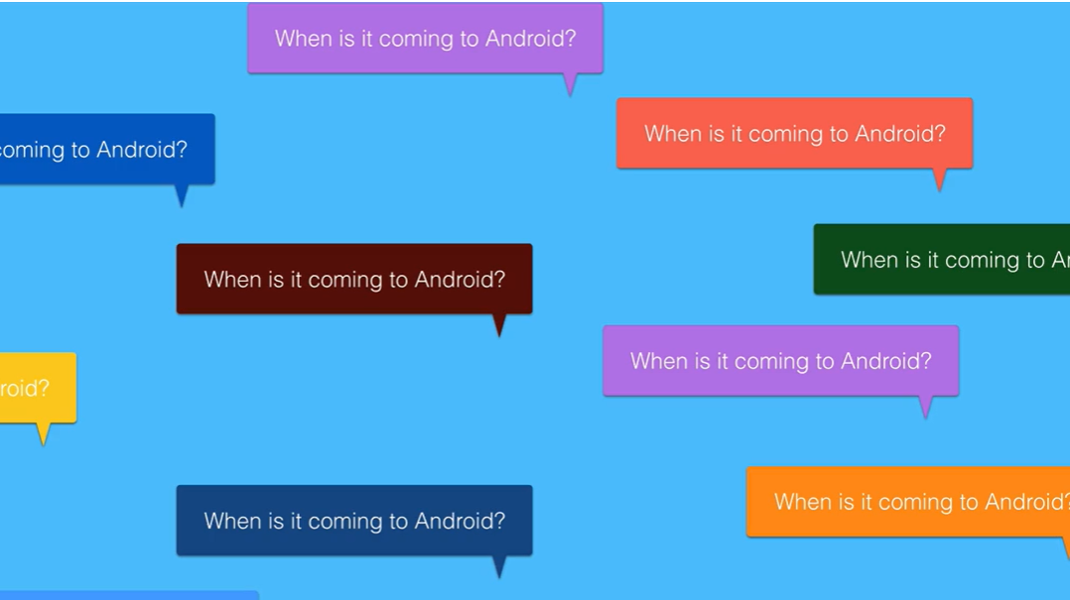

Slide 35


Slide 36


Slide 37
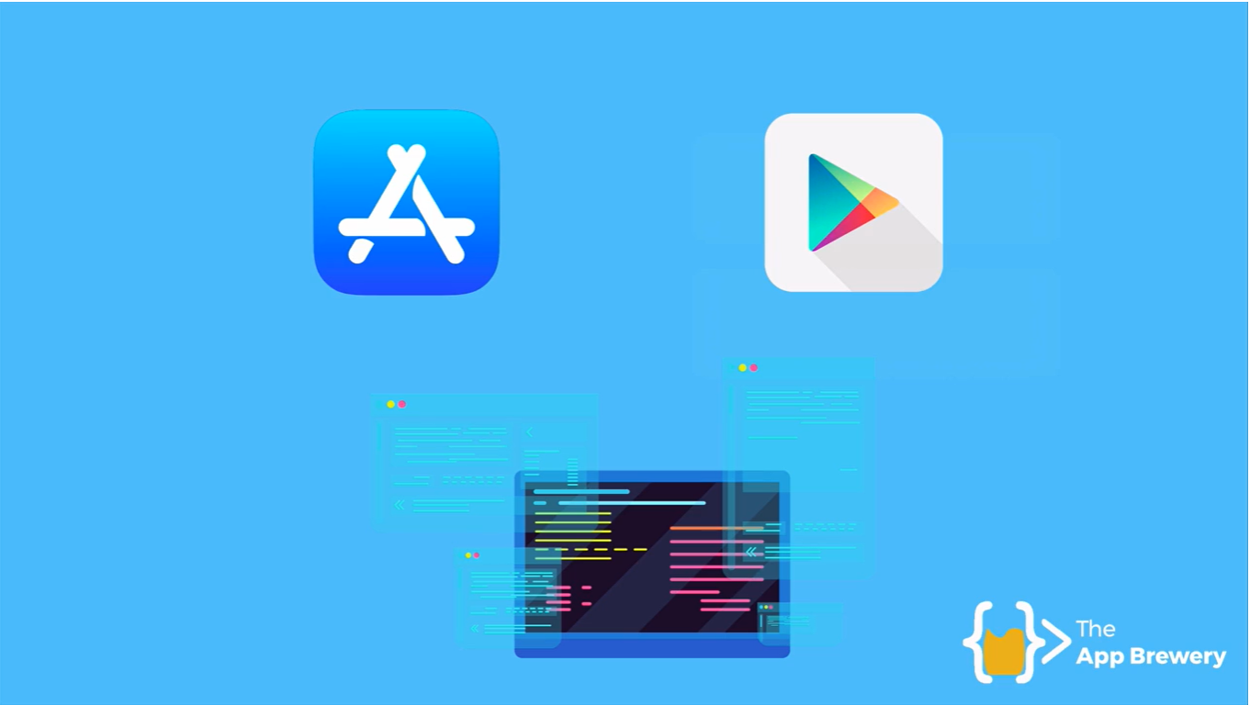

Slide 38
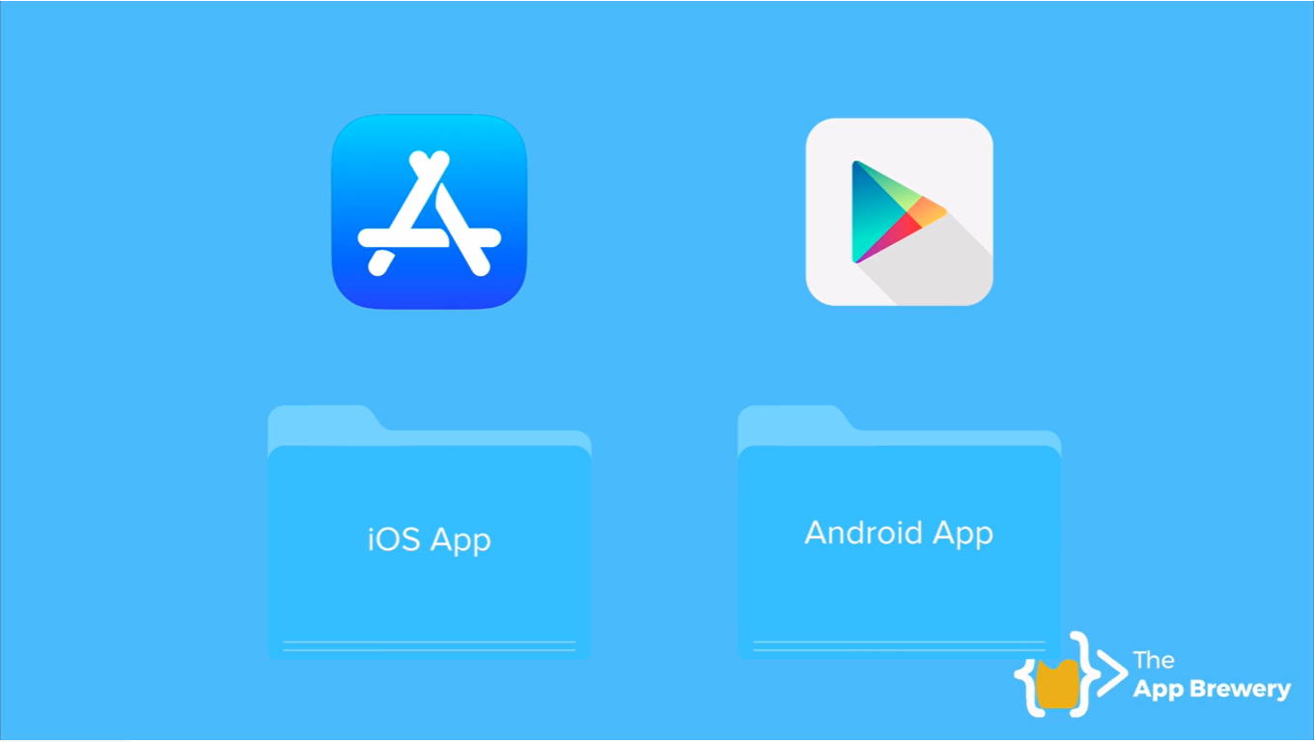

Slide 39
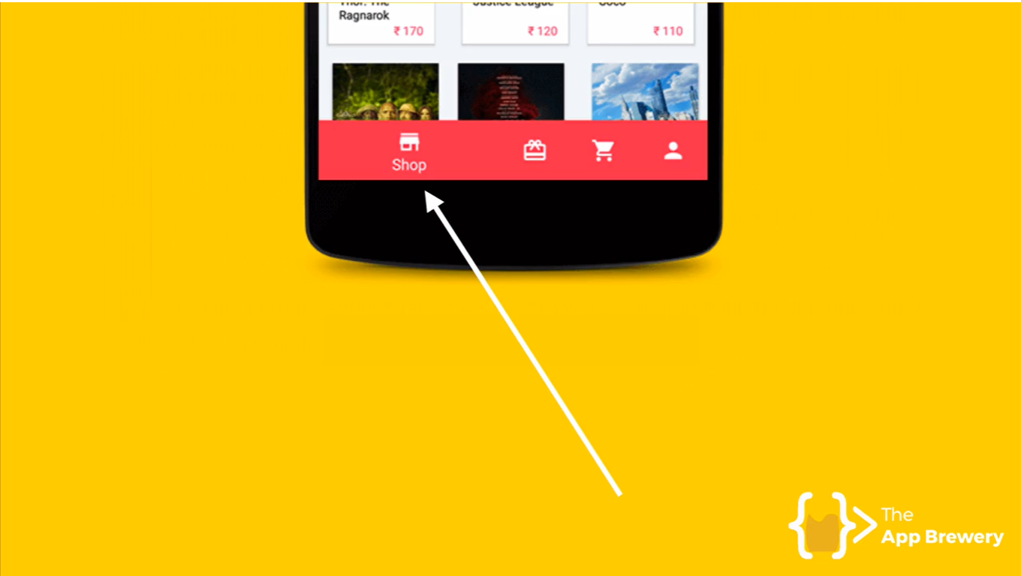

Slide 40
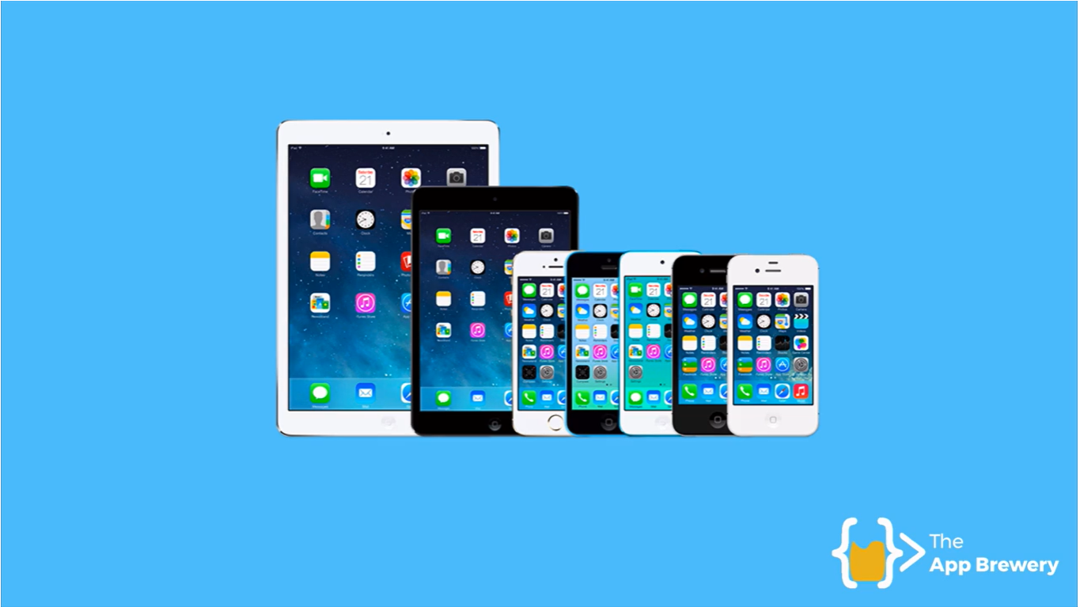

Slide 41
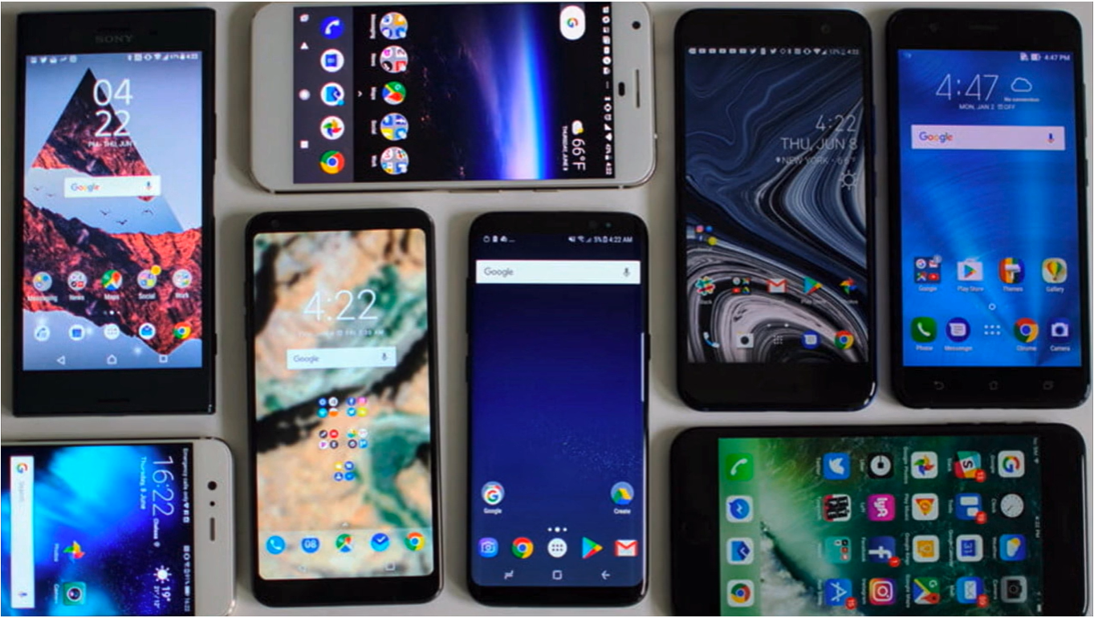

Slide 42


Slide 43
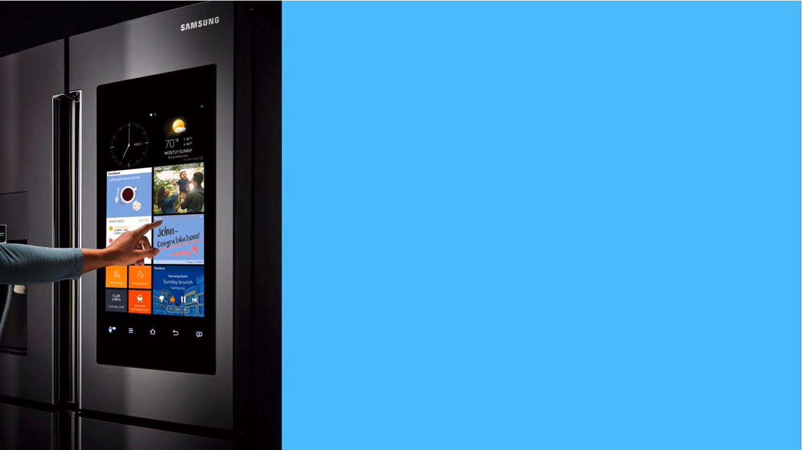

Slide 44
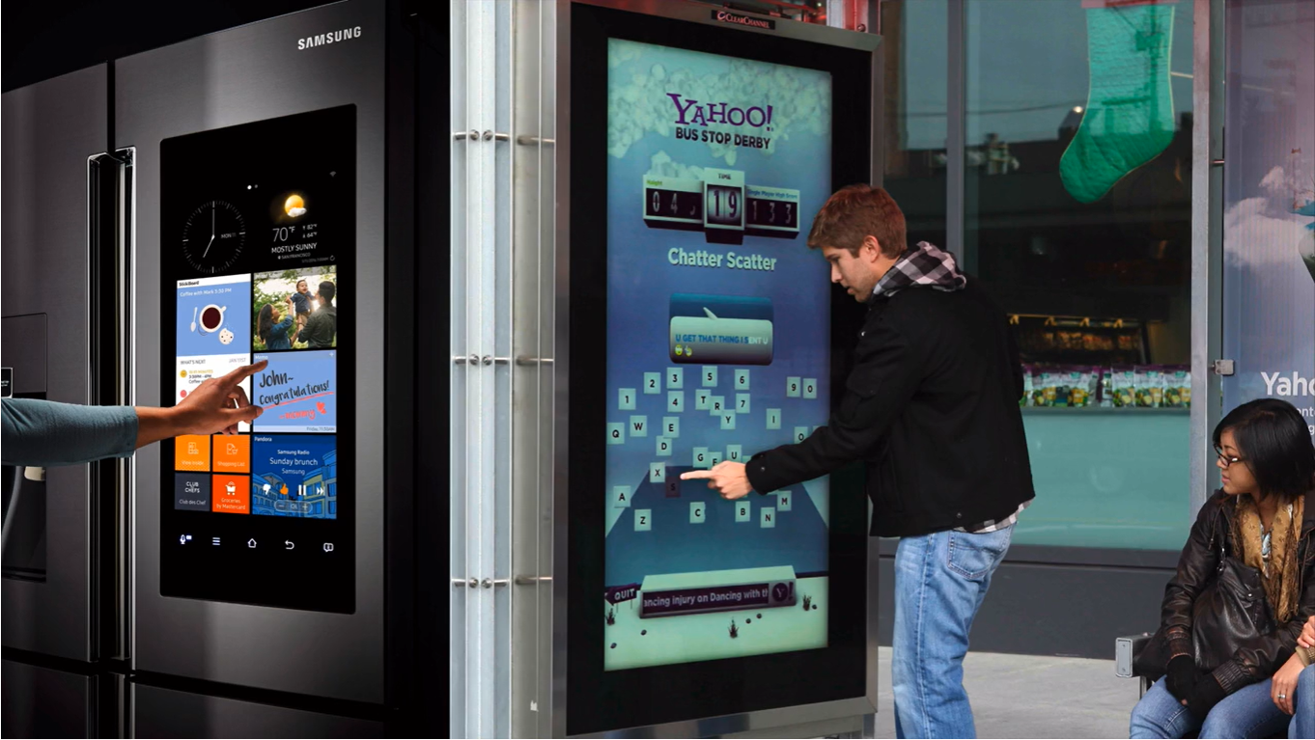

Slide 45
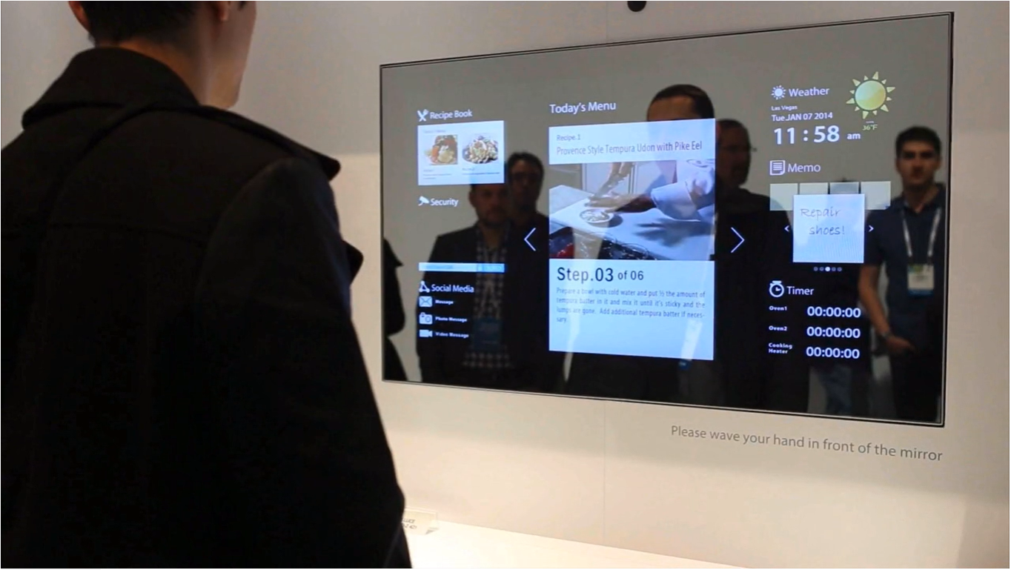

Slide 46
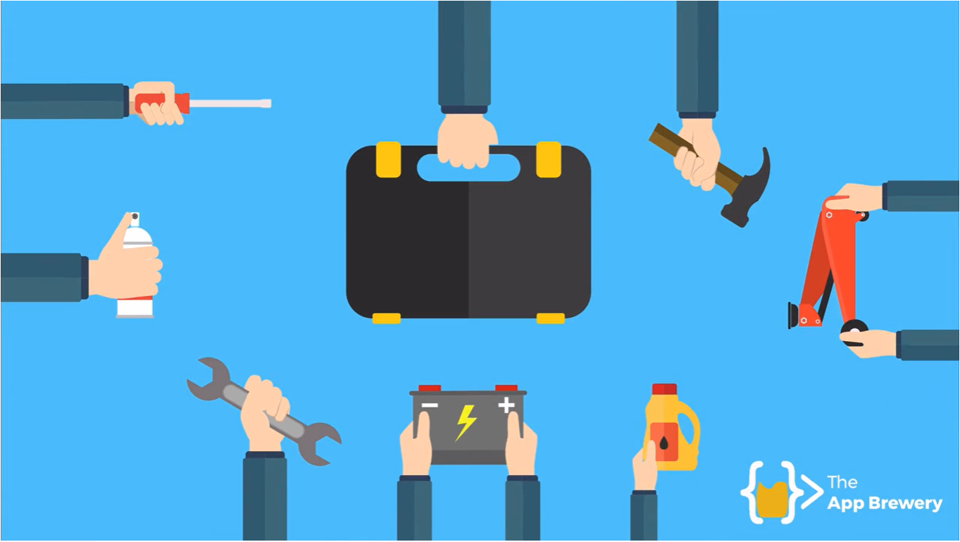

Slide 47
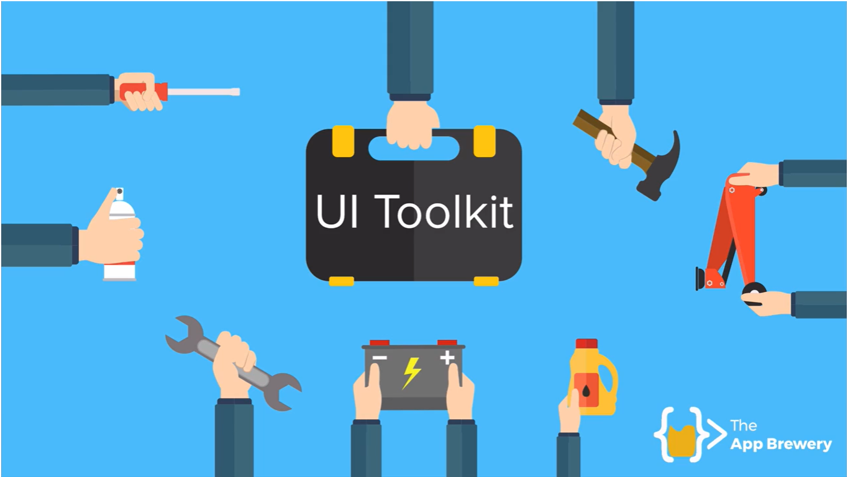

Slide 48
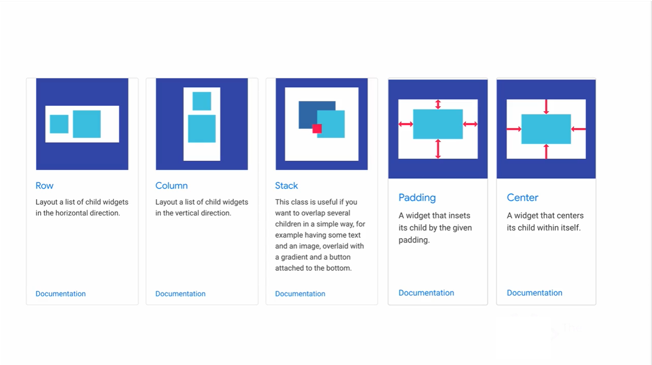

Slide 49
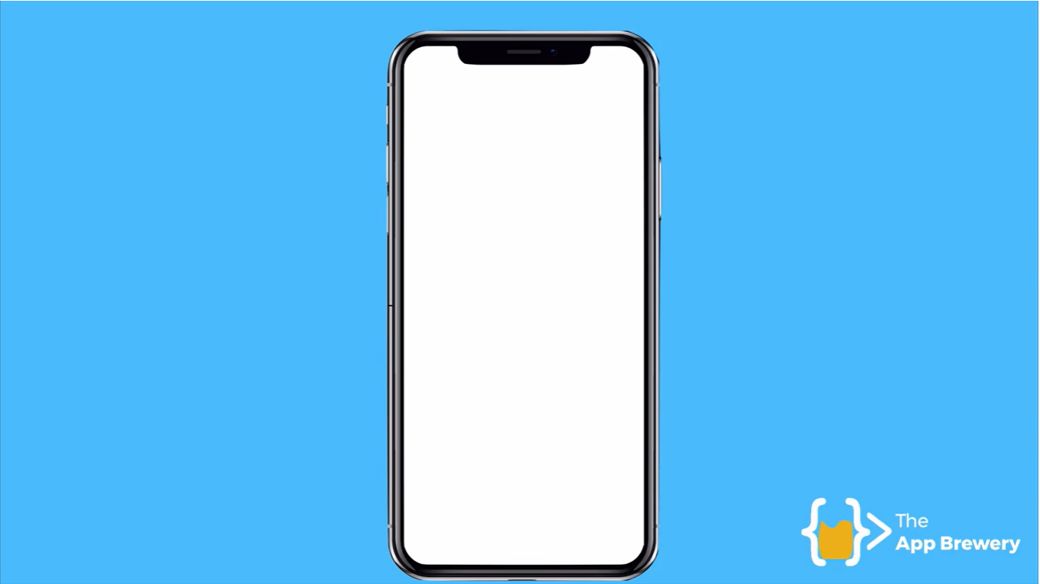

Slide 50
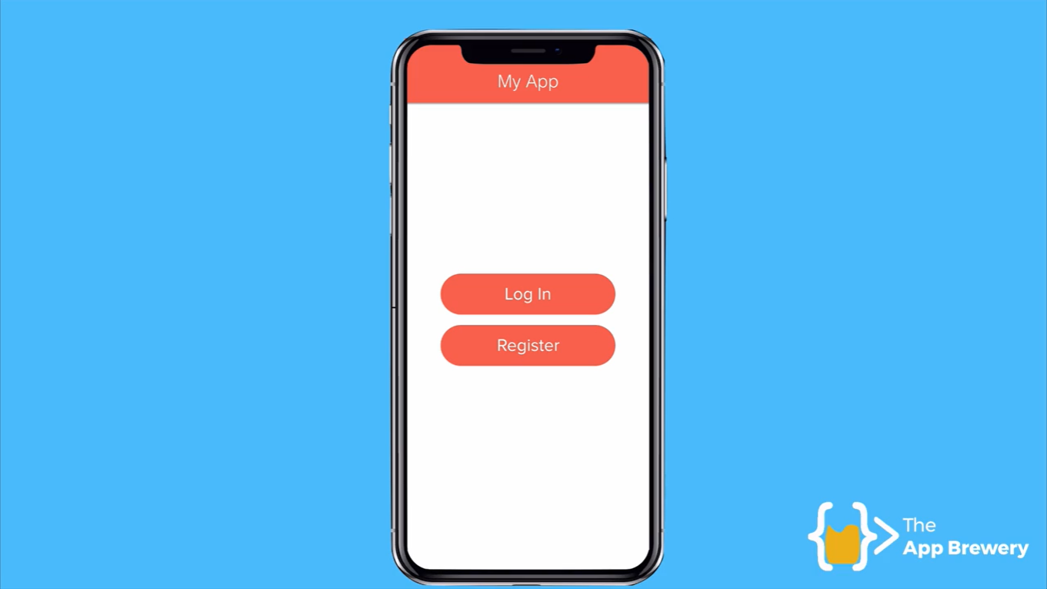

Slide 51
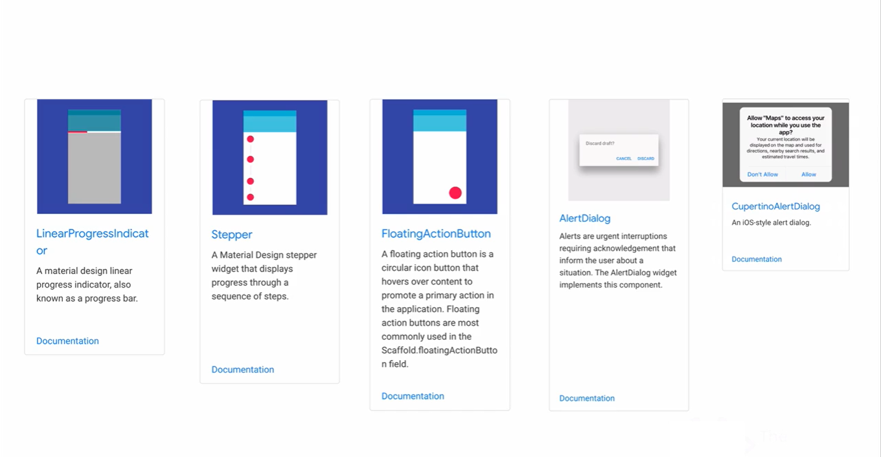

Slide 52


Slide 53
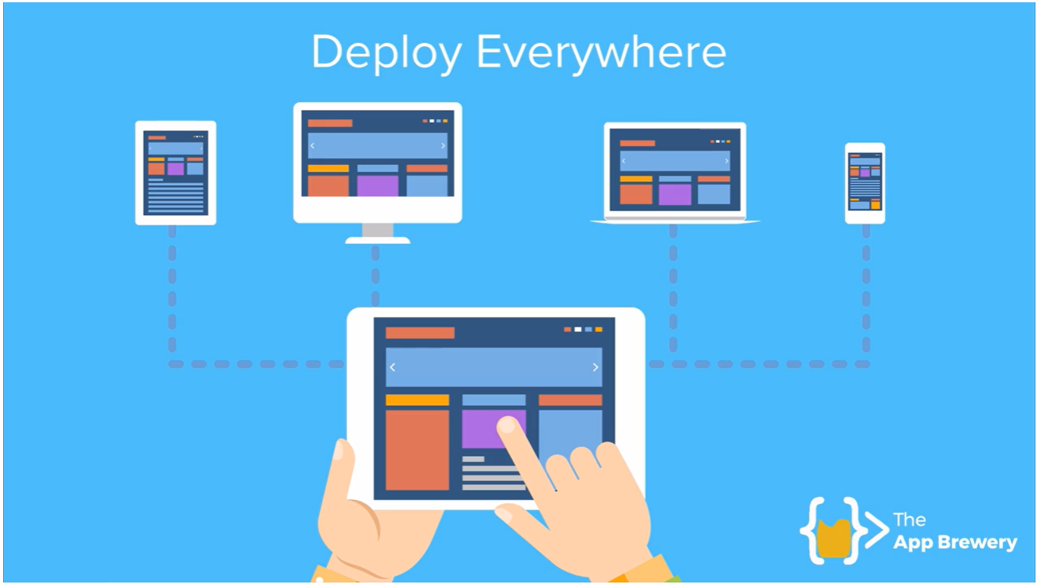

Slide 54
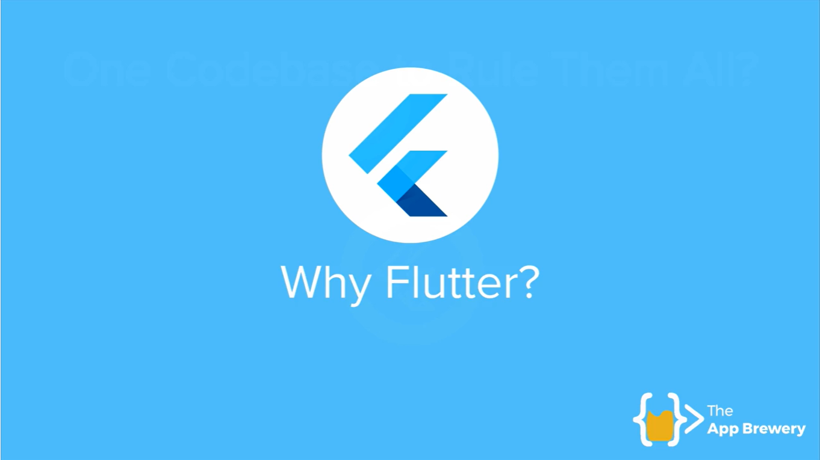

Slide 55
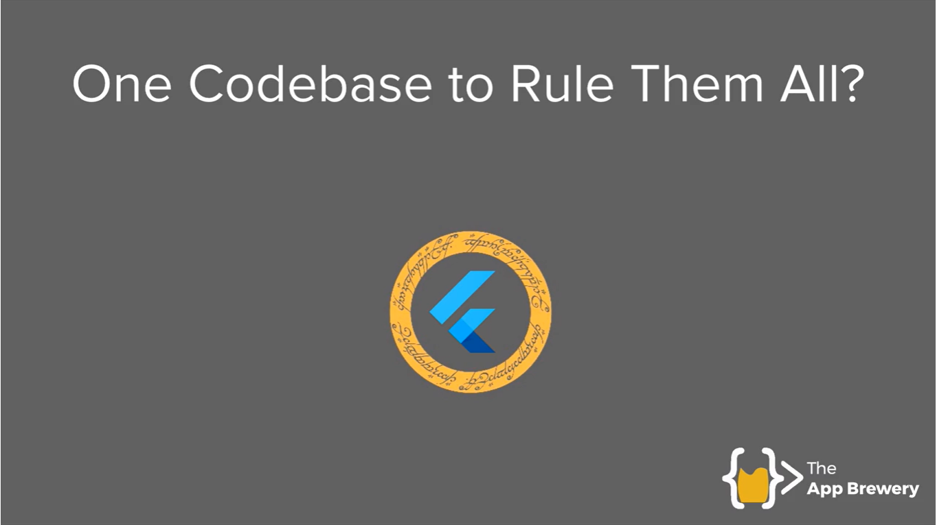

Slide 56
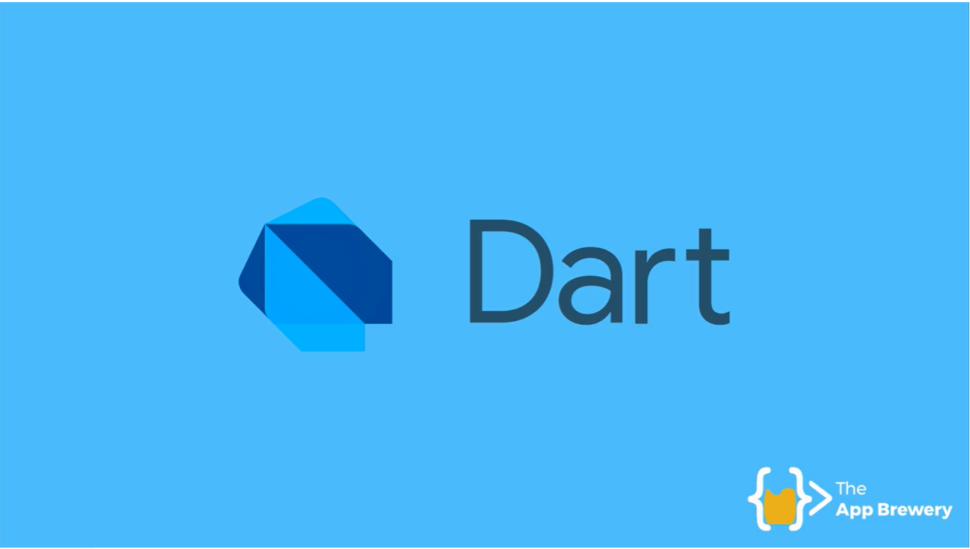

Slide 57
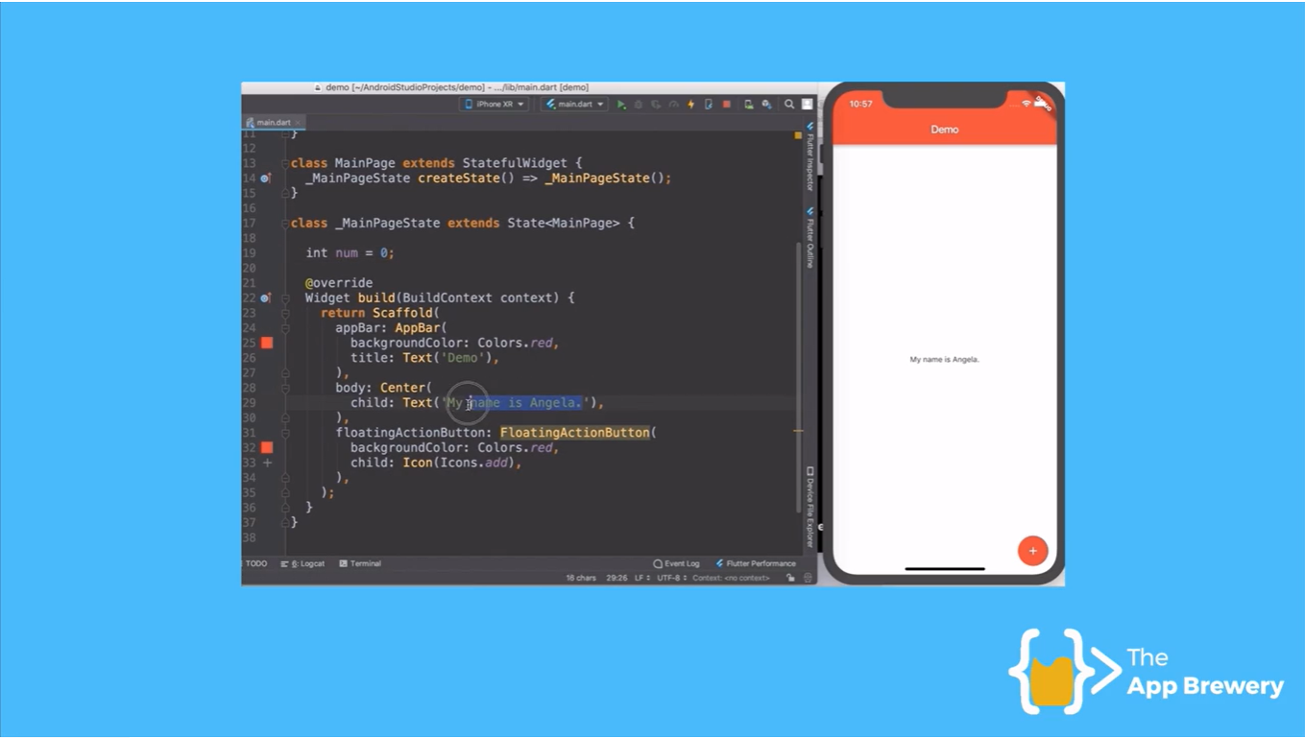

Slide 58
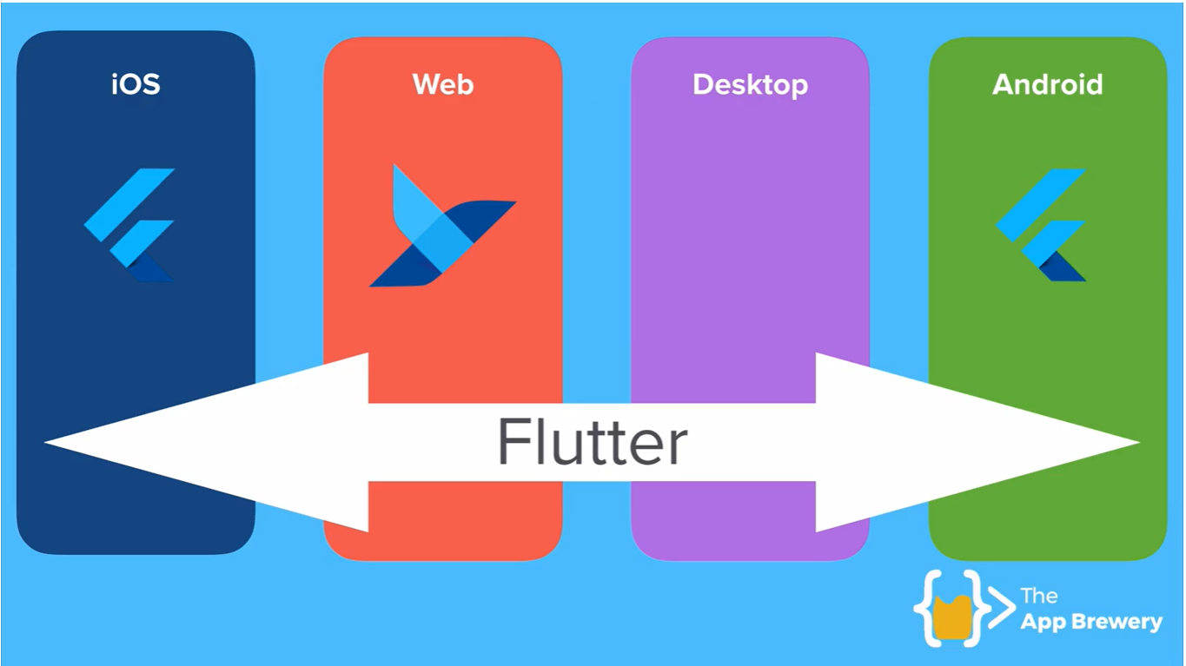

Slide 59
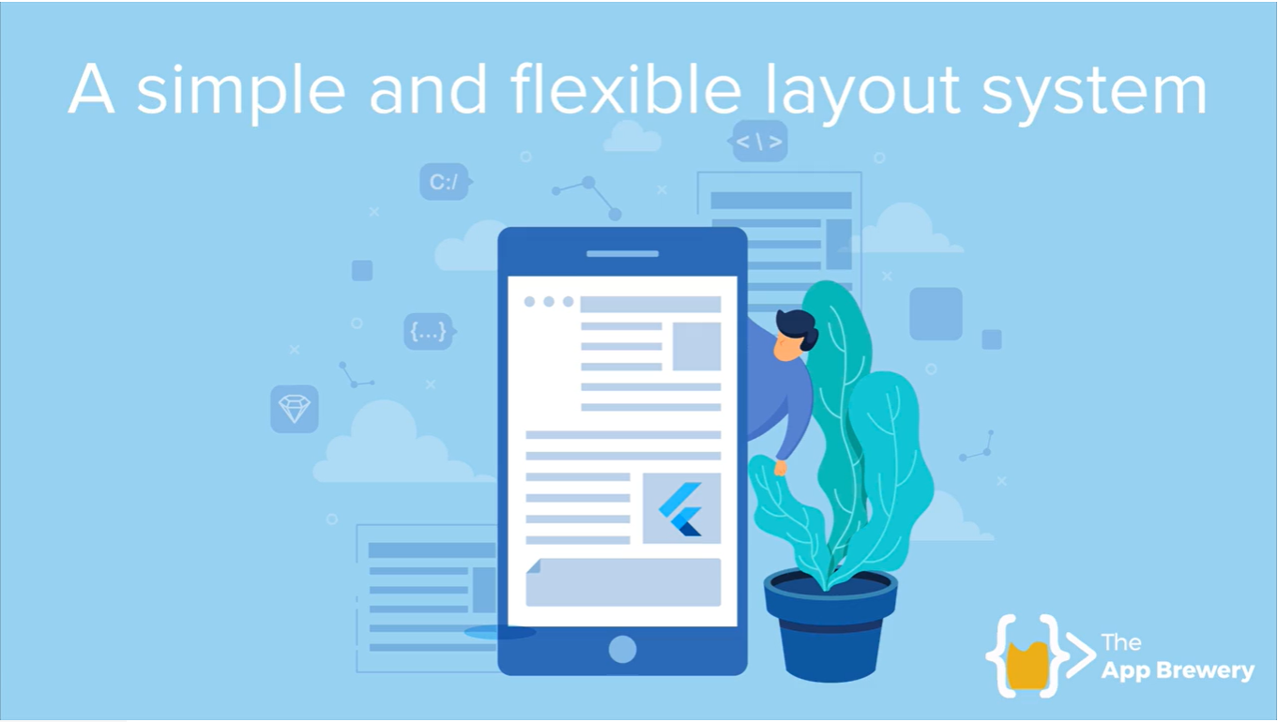

Slide 60


Slide 61
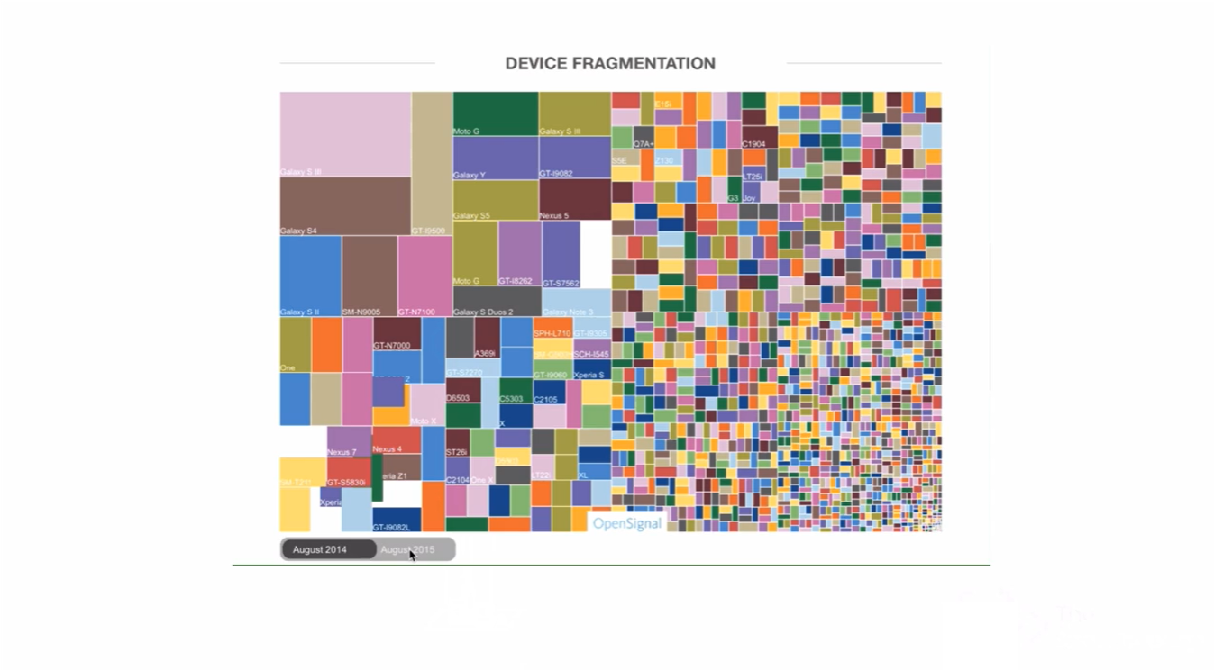

Slide 62
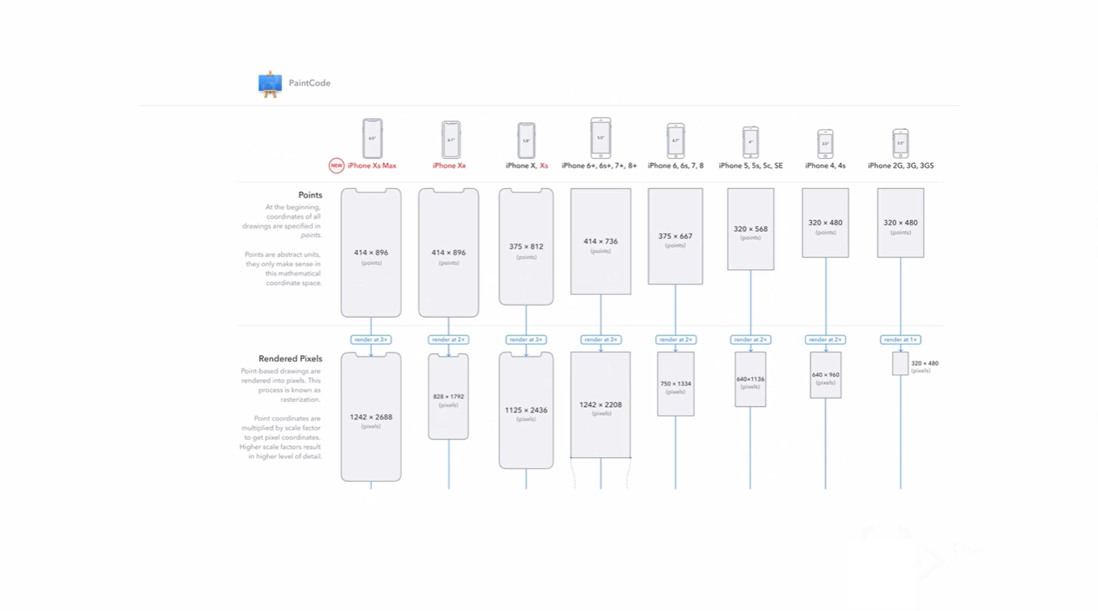

Slide 63
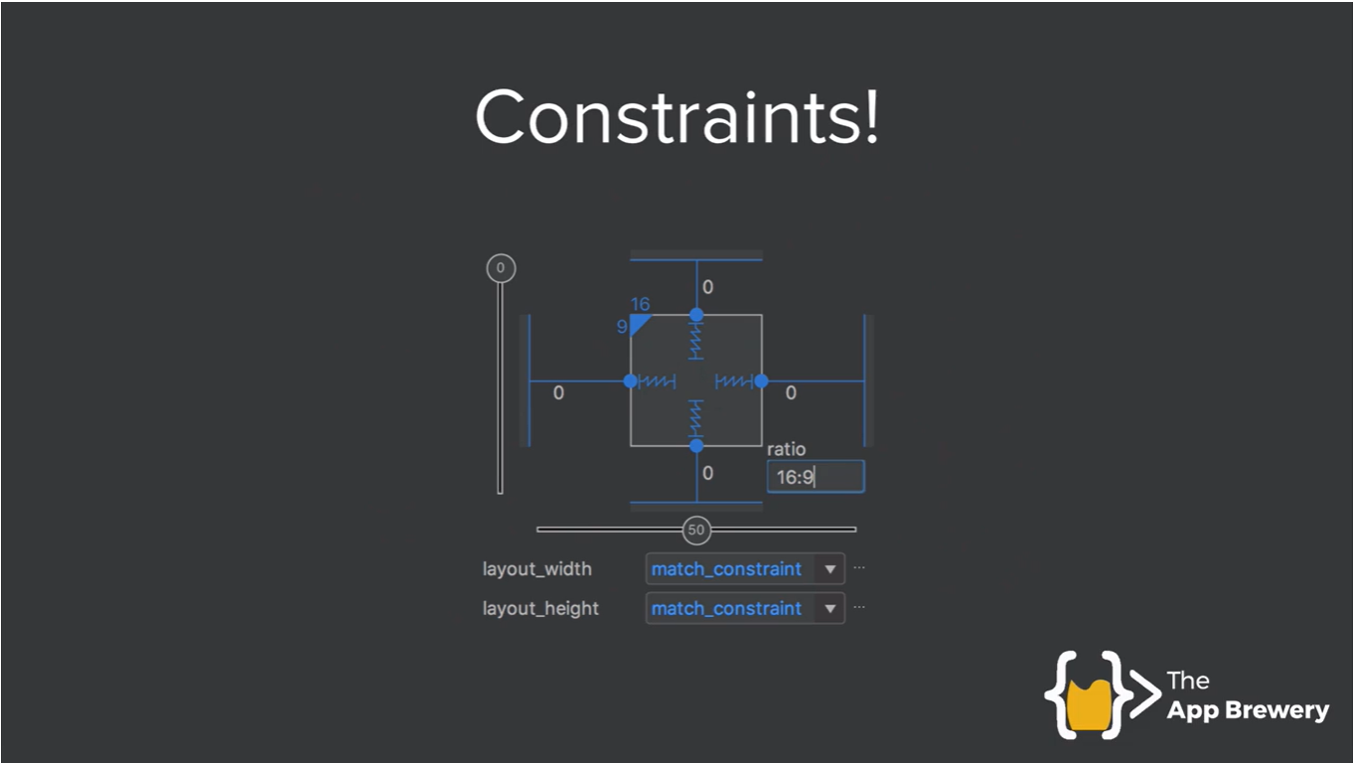

Slide 64
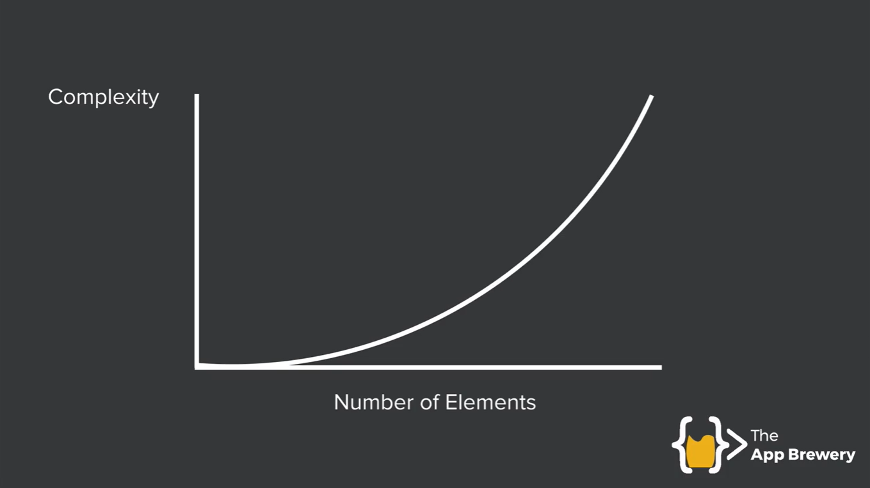

Slide 65
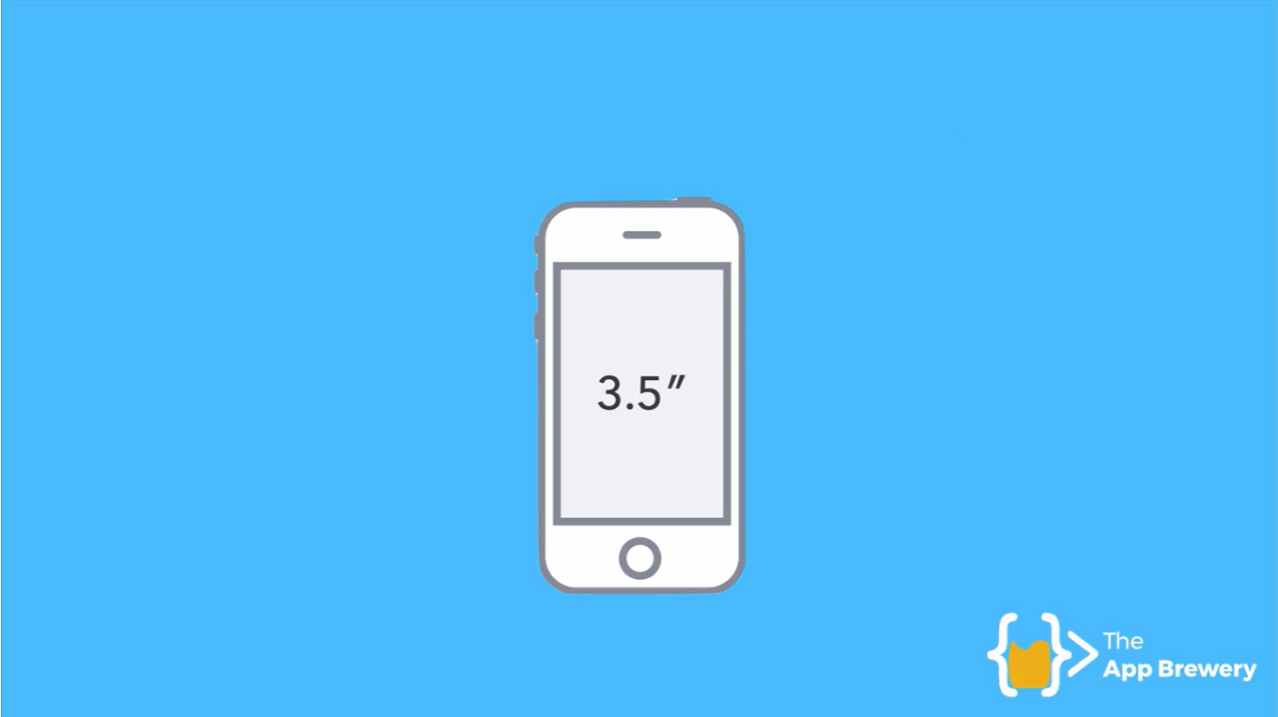

Slide 66


Slide 67


Slide 68


Slide 69


Slide 70


Slide 71


Slide 72


Slide 73


Slide 75


Slide 76


Slide 77


Slide 78


Slide 79


Slide 80


Slide 81


Slide 82


Slide 83


Slide 84


Slide 85


Slide 86


Slide 87


Slide 88


Slide 89


Slide 90


Slide 91


Slide 92


Slide 93


Slide 94


Slide 95


Slide 96


Slide 97


Slide 98


Slide 99


Slide 100


Slide 101


Slide 102


Slide 103


Slide 104


Slide 105


Slide 106


Slide 107


Slide 108


Slide 109


Slide 110


Slide 111


Slide 112


Slide 113


Slide 114


Slide 115


Slide 116


Slide 117


Slide 118


Slide 119


Slide 120


Slide 121


Slide 122


Slide 123


Slide 124


Slide 125


Slide 126


Slide 127


Slide 128


Slide 129


Slide 130


Slide 131


Slide 132


Slide 133


Slide 134


Slide 135


Slide 136


Slide 137


Slide 138


Slide 139


Slide 140


Slide 141


Slide 142


Slide 143


Slide 144


Slide 147


Slide 148


Slide 149


Slide 150


Slide 151


Slide 152

Is there anyone here who doesn’t like to see movies?

Slide 153


Slide 154


Slide 155


Slide 156
React is..
Declarative
Component-Based
Learn Once, Write Anywhere

Slide 157


Slide 158

The software stack

Slide 159



Bugdroid
The android logo designer Irina Blok,
who created the logo was told,
should involve a robot
Stripped-down robot with
a tin-can-shaped torso and
antennas on his head.
Pictograms of the
universal man and woman

Slide 160


Slide 161


Slide 162


Slide 163


Slide 164


Slide 165


Slide 166


Slide 167


Slide 168










Popular Mobile OS Platforms

Slide 169

Why Android?

Slide 170


Slide 171

Devices supported by android.

Slide 172

Platforms

Slide 173

Platforms

Slide 174











Slide 175




Languages

Slide 176

Number of apps available in leading app stores as of 1st quarter 2018

Slide 177

Android operating system share worldwide by OS version from 2013 to 2018

Slide 178

Number of available applications in the Google Play Store from December 2009 to June 2018

Slide 179

Google's revenue worldwide from 2002 to 2017 (in billion U.S. dollars)

Slide 180

Leading Android apps in the Google Play Store worldwide in April 2018, by revenue (in million U.S. dollars)

Slide 181

Most popular Google Play app store categories from 1st quarter 2016 to 1st quarter 2018, by number of downloads (in millions)

Slide 182
Android
Every day more than 1 million new Android devices are activated worldwide.
Android powers hundreds of millions of mobile devices in more than 190 countries around the world.
Android has a share of 80% in the global Smartphone market.
The share of Android in the global Smartphone market has been led by Samsung products, which is around 65%.
Available in 100+ different languages.
Building on the contributions of the open-source Linux community.
More than 500 hardware, software and carrier partners.
Android users download more than 1.5 billion apps and games from Google Play each month.
Google announced that the Play Store now had one million applications listed and it had over 50 billion downloads.
Official website: http://www.android.com
Android means “Humanoid Robot” (a male robot).
On the other hand, a female looking robot is called “Gynoid“.
Android Logo is Called “BugDroid”
It took 4 Years for First Android Phone to be Released (2004-2007)
Android Inc. was started in October 2003.
First android mobile was HTC T1, was released in 2007.
Single app binary that's optimized for both phone and tablet form factors.
At runtime, Android applies the correct resource sets based on its screen size, density, locale, and so on.
XML layouts for UI design.

Slide 183




















Places for Distributing Application

Slide 184

Get Started with Publishing your Android Application on Google Play

Slide 185
Step 1: Register for a Publisher Account
Visit the Google Play Developer Console.
Enter basic information about your developer identity — name, email address, and so on. You can modify this information later.
Read and accept the Developer Distribution Agreement for your country or region.
Pay a $25 USD registration fee using Google payments.
When your registration is verified, you’ll be notified.

Slide 186
Step 2: Set Up a Google Payments Merchant Account
If you want to sell priced apps, in-app products, or subscriptions, you’ll need a Google payments merchant account.
Google Payments Merchant Account can be set one up at any time, after reviewing the list of merchant countries.

Slide 187

Step 3: Explore the Developer Console
When your registration is verified, you can sign in to your Developer Console, which is the home for your app publishing operations and tools on Google Play.

Slide 188



App
Monetization

Slide 189
Ways to earn money from an android app:
Paid App -- user has to pay a one time pre-defined cost set by the developer to download the app from play store.
In-App-Purchase -- The app can be both paid or free but you can add special features in the app for which you can charge user.
For example: additional lives in a game or virtual money to buy goods in a game

Slide 190
Ways to earn money from an android app:
Showing Ads in the app -- Again your app can be both free/paid and you can show ads in the app via using any ad provider like admob or inmobi etc.
Multiple markets -- There is a lot to be gained from pursuing multiple app stores, but one thing in common amongst all of the app stores is that every market takes a cut of your sales

Slide 191


Slide 192



Required Software
Option 1:
Eclipse
Android Developer Tools
SDK
JDK
Option 2:
Android Studio
SDK
JDK

Slide 193

Microsoft® Windows® 7/8/10 (32- or 64-bit)
3 GB RAM minimum, 8 GB RAM recommended; plus 1 GB for the Android Emulator
2 GB of available disk space minimum,4 GB Recommended
(500 MB for IDE + 1.5 GB for Android SDK and emulator system image)
1280 x 800 minimum screen resolution
JDK latest version

Slide 194




C:\Users\<user_name>\AppData\Local\Android\sdk
Android Studio
SDK

Slide 195











Emulator

Slide 196

Basic Application Components

Slide 197

Activity
Basic Application Components

Slide 198

Activity
Basic Application Components

Slide 199


Intent
Basic Application Components

Slide 200

Service
Basic Application Components

Slide 201

Broadcast Receivers
Basic Application Components

Slide 202

Broadcast Receivers
Basic Application Components

Slide 203

Content Providers
Basic Application Components

Slide 204

Content Providers
Basic Application Components

Slide 205

Project structure
setContentView(R.layout.activity_main);

Slide 206





Some useful Online Resources
Android Developer website
http://developer.android.com/index
Stackoverflow
http://stackoverflow.com/
Tutorials point
http://www.tutorialspoint.com/android/
Courseera
http://www.courseera.com
Android Official Website
http://www.android.com/

Slide 207

http://android-developers.blogspot.in/

Slide 208



Books: Novice

Slide 209




Books: Intermediate & Advanced

Slide 210


Books: Intermediate & Advanced

Slide 211




Books: Intermediate & Advanced

Slide 212
References
http://developer.android.com/index.html
http://www.tutorialspoint.com/android/index.htm
http://www.tutorialspoint.com/phonegap/index.htm
http://www.android.com/
https://play.google.com/store?hl=en
http://www.amazon.com/gp/mas/get-appstore/android/ref=mas_rw_ldg
http://gizmodo.com/how-much-happens-on-the-internet-every-60-seconds-950463150
https://en.wikipedia.org/wiki/Android_(operating_system)
https://en.wikipedia.org/wiki/Android_version_history

Slide 213


Slide 214

JAVA
Truly platform-independent (that is, architecture-neutral)
Emergence of the World Wide Web, Java was propelled to the forefront of computer language design
Internet version of C++.
Java was influenced by C++, it is not an enhanced version of C++
Notes:
language that could be used to create software to be embedded in various consumer electronic
devices, such as microwave ovens and remote controls.
As you can probably guess, many
different types of CPUs are used as controllers. The trouble with C and C++ (and most other
languages) is that they are designed to be compiled for a specific target. Although it is possible
to compile a C++ program for just about any type of CPU, to do so requires a full C++ compiler
targeted for that CPU.

Slide 215
JVM
JVM (Java Virtual Machine) is an abstract machine.
It is a specification that provides runtime environment in which java bytecode can be executed.
The JVM performs following main tasks
Loads code
Verifies code
Executes code
Provides runtime environment

Slide 216

JRE
It is the implementation of JVM.
It physically exists.
It contains set of libraries + other files that JVM uses at runtime.

Slide 217

JVM JRE JDK

Slide 218


Slide 219
JVM, JRE and JDK

Slide 220
Environment variables
Environment variables are global system variables accessible by all the
processes running under the Operating System
PATH =“C:\Program Files\Java\jdk1.7.0_67\bin”
CLASSPATH =“C:\Program Files\Java\jdk1.7.0_67\lib”
JAVA_HOME =“C:\Program Files\Java\jdk1.7.0_67”
JRE_HOME= “C:\Program Files\Java\jre7”

Slide 221

Verification of JAVA installation

Slide 222

Verification of JAVA installation

Slide 223



Slide 224

OOP
Notes:
The invention of C++ was not an attempt to create a completely new programming language. Instead, it was an
enhancement to an already highly successful one.

Slide 225
Introducing Classes and objects
Class is an template for an object
Object is an instance of a class.
Class is declared by use of the class keyword
The data, or variables, defined within a class are called instance variables

Slide 226


Slide 227



Slide 228
class classname{
type instance_variable_1;
type instance_variable_2;
.
.
type instance_variable_n;
type methodname1(parameter-list){
//body of the method
}
type methodname2(parameter-list){
//body of the method
}
//…
type methodnamen(parameter-list){
//body of the method
}
}

Slide 229
Simple class
Class add{
Int Num1;
Int Num2;
Int Result;
}
Class defines new type of data
In this case, new data type is called Add
Class name - Add
Variable names – Num1, Num2, Result
Data type - Integer

Slide 230
new operator dynamically allocates memory for an object. It has this general form:
class-var = new classname( );

Slide 231



Inheritance

Slide 232



Inheritance

Slide 233

Polymorphism

Slide 234


Encapsulation

Slide 235
Encapsulation
public class Student{
private String name;
public String getName(){
return name;
}
public void setName(String name){
this.name=name
}
}
class Test{
public static void main(String[] args){
Student s=new Student();
s.setname("vijay");
System.out.println(s.getName());
}
}

Slide 236




Abstraction

Slide 237
Types of errors
Basically three types of errors that you must contend with when writing computer programs:
Syntax errors
Runtime errors
Logic errors

Slide 238

Keypad: Calculator or Phone Dialer

Slide 239

Simple Media Player

Slide 240

Android View Hirarchy

Slide 241


Slide 242

Layouts

Slide 243
Layouts
A layout defines the visual structure for a user interface, such as the UI for an activity or app widget.
Linear Layout
Relative Layout
Absolute layout
Frame layout
Box layout
List View
Grid View

Slide 244
setContentView(R.layout.activity_main);

Slide 245



<Button
android:id="@+id/button1"
android:layout_width="wrap_content"
android:layout_height="wrap_content"
android:text="Button"/>
<EditText
android:id="@+id/editText1"
android:layout_width="wrap_content"
android:layout_height="wrap_content"/>
<Spinner
android:id="@+id/spinner1"
android:layout_width="wrap_content"
android:layout_height="wrap_content" />

Slide 246

Widget height and length
Parent

Slide 247

Layouts: Linear Layout
Linear layout is a view group that aligns all children in a single direction,
Vertically.
Horizontally.

Slide 248
Widget height and length
+ layout
Parent

Slide 249
Widget height and length
Fill-parent (Match parent)
Wrap-Content
+ layout
Parent

Slide 250
Widget height and length
Layout
Parent
Fill Parent - Width
Fill Parent - Height

Slide 251
Widget height and length
Layout
Fill Parent - Width
Fill Parent - Height
Orientation - Vertical / Horizontal
Parent

Slide 252
<?xml version="1.0" encoding="UTF-8"?>
<LinearLayout
xmlns:android="http://schemas.android.com/apk/res/android"
android:layout_height="fill_parent"
android:layout_width="fill_parent"
android:orientation="vertical"
>
<!--Content of the layout->
</LinearLayout>

Slide 253
<?xml version="1.0" encoding="UTF-8"?>
<LinearLayout
xmlns:android="http://schemas.android.com/apk/res/android"
android:layout_height="fill_parent"
android:layout_width="fill_parent"
android:orientation="horizontal"
>
<!--Content of the layout->
</LinearLayout>

Slide 254

Widget height and length
Layout
Ok
Parent
Cancel
Next

Slide 255
Widget height and length
Fill Parent - Width
Fill Parent - Height
Orientation - Vertical and Horizontal
Layout
Parent
Ok
Cancel
Next

Slide 256

Widget height and length
Parent
(Device screen)
Width
Height
Orientation
Layout
(Linear layout)
Ok
Cancel
Next
Width
Height
Width
Height
Width
Height

Slide 257
Widget height and length
Width –
Fill Parent (Match parent)
Wrap content
Height –
Fill Parent (Match parent)
Wrap content
Orientation –
Vertical
Horizontal

Slide 258

Widget height and length
Parent
Layout
Width
Height
Orientation
Layout
Parent
Ok
Cancel
Next
Width
Height
Width
Height
Width
Height

Slide 259
<?xml version="1.0" encoding="UTF-8"?>
<LinearLayout
xmlns:android="http://schemas.android.com/apk/res/android"
android:layout_height="fill_parent"
android:layout_width="fill_parent"
android:orientation="horizontal"
>
<Button
android:layout_width="fill_parent"
android:layout_height="wrap_content"
android:text="Ok"
android:id="@+id/ok“
android:onClick=“fun_ok“/>
..
..
</LinearLayout>

Slide 260

Widget height and length
Parent
Ok
Width
Height
Orientation
Layout
Cancel
Parent
Next
Ok
Cancel
Next
Width
Height
Width
Height
Width
Height

Slide 261
Widget height and length
Parent
Ok
Width
Height
Orientation
Layout
Cancel
Parent
Next
Ok
Cancel
Next
Width
Height
Width
Height
Width
Height

Slide 262
<?xml version="1.0" encoding="UTF-8"?>
<LinearLayout
xmlns:android="http://schemas.android.com/apk/res/android"
android:layout_height=“wrap_content"
android:layout_width="fill_parent"
android:orientation=“vertical"
>
<Button
android:layout_width="fill_parent"
android:layout_height="wrap_content"
android:text="Ok"
android:id="@+id/ok“
android:onClick=“fun_ok“/>
..
..
</LinearLayout>

Slide 263



Widget height and length
Parent
Ok
Width
Height
Orientation
Layout
Cancel
Parent
Next
Ok
Cancel
Next
Width
Height
Width
Height
Width
Height

Slide 264
<?xml version="1.0" encoding="UTF-8"?>
<LinearLayout
xmlns:android="http://schemas.android.com/apk/res/android"
android:layout_height="fill_parent"
android:layout_width="fill_parent"
android:orientation=“vertical"
>
<Button
android:layout_width=“wrap_content"
android:layout_height="wrap_content"
android:text="Ok"
android:id="@+id/ok“
android:onClick=“fun_ok“/>
..
..
</LinearLayout>

Slide 265
Widget height and length
Parent
Ok
Width
Height
Orientation
Layout
Cancel
Parent
Next
Ok
Cancel
Next
Width
Height
Width
Height
Width
Height

Slide 266
<?xml version="1.0" encoding="UTF-8"?>
<LinearLayout
xmlns:android="http://schemas.android.com/apk/res/android"
android:layout_height=“wrap_content"
android:layout_width="fill_parent"
android:orientation=“vertical"
>
<Button
android:layout_width=“wrap_content"
android:layout_height="wrap_content"
android:text="Ok"
android:id="@+id/ok“
android:onClick=“fun_ok“/>
..
..
</LinearLayout>

Slide 267
Widget height and length
Parent
Ok
Width
Height
Orientation
Layout
Cancel
Parent
Next
Ok
Cancel
Next
Width
Height
Width
Height
Width
Height

Slide 268
<?xml version="1.0" encoding="UTF-8"?>
<LinearLayout
xmlns:android="http://schemas.android.com/apk/res/android"
android:layout_height=“wrap_content"
android:layout_width=“wrap_content"
android:orientation=“vertical"
>
<Button
android:layout_width=“wrap_content"
android:layout_height="wrap_content"
android:text="Ok"
android:id="@+id/ok"/>
..
..
</LinearLayout>

Slide 269



Widget height and length
Parent
Ok
Cancel
Next
Width
Height
Orientation
Layout
Parent
Ok
Cancel
Next
Width
Height
Width
Height
Width
Height

Slide 270
<?xml version="1.0" encoding="UTF-8"?>
<LinearLayout
xmlns:android="http://schemas.android.com/apk/res/android"
android:layout_height="fill_parent"
android:layout_width="fill_parent"
android:orientation=“horizontal"
>
<Button
android:layout_width=“wrap_content"
android:layout_height="wrap_content"
android:text="Ok"
android:id="@+id/ok“
android:onClick=“fun_ok“/>
..
..
</LinearLayout>

Slide 271
Widget height and length
Parent
Ok
Cancel
Next
Width
Height
Orientation
Layout
Parent
Ok
Cancel
Next
Width
Height
Width
Height
Width
Height

Slide 272

Keypad

Slide 273
Keypad

Slide 274
Keypad
Parent
Linear Layout
( Vertical )
Linear Layout
(Horizontal)
Linear Layout
(Horizontal)
Linear Layout
(Horizontal)
Linear Layout
(Horizontal)
B1
B2
B3
B4
B5
B6
B7
B8
B9
B*
B0
B#

Slide 275
Keypad
Parent
Linear Layout
( Vertical )
Edit Text
Linear Layout
(Horizontal)
Linear Layout
(Horizontal)
Linear Layout
(Horizontal)
Linear Layout
(Horizontal)
Button
B1
B2
B3
B4
B5
B6
B7
B8
B9
B*
B0
B#

Slide 276

Android Project Structure

Slide 277
1
2
3
4
5
6
Parent
7
8
9
+
0
*

Slide 278
1
2
3
4
5
6
Parent
7
8
9
+
0
*

Slide 279
XML File: User Interface
Linear Layout
Orientation: Vertical
Layout height: Fill Parent
Layout width: Fill Parent
Linear Layout
Orientation: Horizontal
Layout height: Wrap content
Layout width: Fill Parent
1
2
3
4
5
6
Parent
7
8
9
+
0
*

Slide 280
XML Layout Code
<?xml version="1.0" encoding="UTF-8"?>
<LinearLayout>
<LinearLayout>
<Button />
<Button />
<Button />
</LinearLayout>
<LinearLayout>
<Button />
<Button />
<Button />
</LinearLayout>
<LinearLayout>
<Button />
<Button />
<Button />
</LinearLayout>
…
…
</LinearLayout>

Slide 281
XML code for generating Button
<Button
android:layout_width=“wrap_content"
android:layout_height="wrap_content"
android:text="Ok"
android:id="@+id/one“/>

Slide 282
Android Project Structure

Slide 283
.Java File (Activity)
package com.example.nitk.myapplication; import android.app.Activity; import android.os.Bundle; public class Main2Activity extends Activity { @Override protected void onCreate(Bundle savedInstanceState) { super.onCreate(savedInstanceState); setContentView(R.layout.activity_main2); } }

Slide 284


Referencing
setContentView(R.layout.activity_main2);
Activity
(.Java)
User Interface (.XML)
findViewById();

Slide 285


Slide 286


Slide 287


Onclick Listeners
Method 1:
Specifying onclick attribute for every button in layout XML file.
Method 2:
Implementing onClickListener interface
Method 3:
Using Anonymous inner class

Slide 288
Method 1: Specifying onclick attribute for every button in layout XML file.
In XML layout file
In Java File
<Button
android:layout_width=“wrap_content”
android:layout_height=“wrap_content”
android:text=“Ok”
android:id=“@+id/ok”
android:onClick=“funOk”/>
public void funOk(View v){
//Logic to execute when the button is pressed }

Slide 289
Method 2: Implementing onClickListener interface
In XML layout file
<Button
android:layout_width=“wrap_content"
android:layout_height="wrap_content"
android:text="Ok"
android:id="@+id/ok“
android:onClick=“funOk“/>

Slide 290
Method 2: Implementing onClickListener interface
public class MainActivity extends Activity implements View.OnClickListener { @Override protected void onCreate(Bundle savedInstanceState) { super.onCreate(savedInstanceState); setContentView(R.layout.activity_main); Button bok; bok=(Button)findViewById(R.id.ok); bok.setOnClickListener(this);}
@Override public void onClick(View v) { int id=v.getId(); switch (id){ case R.id.ok: //This will be executed when ok button is pressed } } }

Slide 291
Method 3:
Using Anonymous inner class
public class MainActivity extends Activity { Button bok; @Override protected void onCreate(Bundle savedInstanceState) { super.onCreate(savedInstanceState); setContentView(R.layout.activity_main); bok=(Button)findViewById(R.id.ok); bok.setOnClickListener(new View.OnClickListener() { @Override public void onClick(View v) { // Code in this part will be executed
when ok button is pressed } });}}

Slide 292

Toast Message
A toast provides simple feedback about an operation in a small popup.
Toast.makeText(context, text, duration).show();
Context context = getApplicationContext(); CharSequence text = “Message Saved as draft."; int duration = Toast.LENGTH_SHORT; Toast toast = Toast.makeText(context, text, duration); toast.show();

Slide 293
Intents
An intent is an abstract description of an operation to be performed.
To start an activity
To start a service
To deliver a broadcast

Slide 294

Intent

Slide 295
Intent
Page 1
Page 2
This is first Activity of your Application
This is second Activity of your Application
Intent
OK
Intent it=new Intent(MainActivity.this, SecondActivity.class); startActivity(it);

Slide 296
Intent with data (Bundle)
Page 1
Page 2
Manoj
Enter your name
Intent
Manoj
OK

Slide 297
Intent with data (Bundle)
Intent it= new Intent(MainActivity.this, Main2Activity.class); Bundle b=new Bundle(); b.putString("name", ((EditText)findViewById(R.id.text)).getText().toString()); it.putExtra("bundle",b); startActivity(it);
Intent it=getIntent(); Bundle b=it.getBundleExtra("bundle"); String s=b.getString("name"); ((TextView)findViewById(R.id.text_to_show)).setText(s);

Slide 298
Database
Enter your name here:
Insert
Retrieve
Contents of the database:

Slide 299
Database
public class Database extends SQLiteOpenHelper { public Database(Context context, String name,
SQLiteDatabase.CursorFactory factory, int version) { super(context, name, factory, version); } @Override public void onCreate(SQLiteDatabase db) { db.execSQL("create table student(name TEXT)"); } @Override public void onUpgrade(SQLiteDatabase db, int oldVersion, int newVersion) { } }

Slide 300
Database: Insert
Database db=new Database(getApplicationContext(),"demo.db",null,1); SQLiteDatabase sdb=db.getWritableDatabase(); ContentValues cv=new ContentValues(); cv.put("name", et.getText().toString()); long l=sdb.insert("student",null,cv); if(l==-1){ Toast.makeText(getApplicationContext(),"not inserted",Toast.LENGTH_LONG).show(); }else{ Toast.makeText(getApplicationContext(),"successfully inserted",Toast.LENGTH_LONG).show(); }

Slide 301
Database: Retrieve
Database db=new Database(getApplicationContext(),"demo.db",null,1); SQLiteDatabase sdb=db.getReadableDatabase(); Cursor c=sdb.query("student",new String[]{"name"},null,null,null,null,null); c.moveToFirst(); TextView tv=(TextView)findViewById(R.id.names); tv.setText(""); String s; do { s=c.getString(c.getColumnIndex("name")); tv.append("\n"+s); }while (c.moveToNext());

Slide 302
Media Player : create
MediaPlayer mp;
mp=MediaPlayer.create(getApplicationContext(),R.raw.song);

Slide 303
Media Player: Play & pause
public void play(View v){ mp.start(); }
public void pause(View v){ mp.pause(); }

Slide 304
Media Player: fast forward & rewind
public void ff(View v){ if((mp.getCurrentPosition()+5000)<=mp.getDuration()){ mp.seekTo((int) mp.getCurrentPosition() + 5000); } }
public void rew(View v){ if(mp.getCurrentPosition()-5000>0){ mp.seekTo((int) mp.getCurrentPosition()-5000); } }

Slide 305

Calling app
Intent dialIntent = new Intent( "android.intent.action.CALL", Uri.parse("tel:3075555555"));
startActivity(dialIntent);
<uses-permission android:name="android.permission.CALL_PHONE"/>

Slide 306

Messaging App
SmsManager smsManager = SmsManager.getDefault();
smsManager.sendTextMessage(phoneNo, null, message, null, null);
Toast.makeText(getApplicationContext(), "SMS sent.", Toast.LENGTH_LONG).show();
<uses-permission android:name="android.permission.SEND_SMS" />

Slide 307

Web browser intent
String url = "http://www.nitk.ac.in";
Intent i = new Intent(Intent.ACTION_VIEW);
i.setData(Uri.parse(url));
startActivity(i);
<uses-permission android:name="android.permission.INTERNET"></uses-permission>

Slide 308

Adapter

Slide 309
Spinner
s=(Spinner)findViewById(R.id.spinner1);
ArrayAdapter< CharSequence> a=ArrayAdapter.createFromResource(this, R.array.a, android.R.layout.simple_spinner_item);
a.setDropDownViewResource(android.R.layout.simple_spinner_dropdown_item);
s.setAdapter(a);
s.setOnItemSelectedListener(this);

Slide 310
ListView
lv=(ListView)findViewById(R.id.listView1);
ArrayAdapter<CharSequence> adap=ArrayAdapter.createFromResource(this, R.array.a, android.R.layout.simple_list_item_1);
lv.setAdapter(adap);
lv.setOnItemSelectedListener(this);

Slide 311

Animation

Slide 312

Animation

Slide 313

Animation: Scale

Slide 314

Animation: Rotate

Slide 315

Animation: alpha

Slide 316


Slide 317


Slide 318


Slide 319


Slide 320
case R.id.zoomInOut:
ImageView image = (ImageView)findViewById(R.id.imageView1);
Animation animation = AnimationUtils.loadAnimation(getApplicationContext(), R.anim.myanimation);
image.startAnimation(animation);
return true;

Slide 321

Google Maps Android API
https://developers.google.com/maps/documentation/android/

Slide 322
Google Maps Android API
Hello Map
Change the Map Type
Indoor Maps
Custom Markers and Info windows
Flat Markers
Polylines

Slide 323
Latitude and longitude
Shimoga
Latitude : 13.929930
Longitude: 75.568101
Davangere
Latitude : 14.466344
Longitude: 75.923840
Bangalore
Latitude : 12.971599
Longitude: 77.594563
BIET Davangere
Latitude : 14.443522
Longitude: 75.902045
Mangalore
Latitude : 12.914142
Longitude: 74.855957
Belgaum
Latitude : 15.849695
Longitude: 74.497674
Delhi
Latitude : 28.613939
Longitude: 77.209021
Calicut
Latitude : 11.258753
Longitude: 75.780410
Chennai
Latitude : 13.082680
Longitude: 80.270718

Slide 324

Hello Map
public class MapPane extends Activity implements OnMapReadyCallback { @Override protected void onCreate(Bundle savedInstanceState) { super.onCreate(savedInstanceState); setContentView(R.layout.map_activity); MapFragment mapFragment = (MapFragment) getFragmentManager().findFragmentById(R.id.map); mapFragment.getMapAsync(this); } @Override public void onMapReady(GoogleMap map) { LatLng sydney = new LatLng(-33.867, 151.206); map.setMyLocationEnabled(true); map.moveCamera(CameraUpdateFactory.newLatLngZoom(sydney, 13)); map.addMarker(new MarkerOptions().title("Sydney").snippet("The most populous city in Australia.") .position(sydney)); } }

Slide 325

Change the Map Type
public class MapPane extends Activity implements OnMapReadyCallback { @Override protected void onCreate(Bundle savedInstanceState) { …. } @Override public void onMapReady(GoogleMap map) { map.moveCamera(CameraUpdateFactory.newLatLngZoom( new LatLng(-18.142, 178.431), 2)); // Other supported types include: MAP_TYPE_NORMAL, // MAP_TYPE_TERRAIN, MAP_TYPE_HYBRID and MAP_TYPE_NONE map.setMapType(GoogleMap.MAP_TYPE_SATELLITE); } }

Slide 326

Indoor Maps
public class MapPane extends Activity implements OnMapReadyCallback { @Override protected void onCreate(Bundle savedInstanceState) { … } @Override public void onMapReady(GoogleMap map) { // Some buildings have indoor maps. Center the camera over // the building, and a floor picker will automatically appear. map.moveCamera(CameraUpdateFactory.newLatLngZoom( new LatLng(-33.86997, 151.2089), 18)); } }

Slide 327

Custom Markers and Info windows
public class MapPane extends Activity implements OnMapReadyCallback { @Override protected void onCreate(Bundle savedInstanceState) { … } @Override public void onMapReady(GoogleMap map) { map.moveCamera(CameraUpdateFactory.newLatLngZoom( new LatLng(41.889, -87.622), 16)); // You can customize the marker image using images bundled
//with your app, or dynamically generated bitmaps. map.addMarker(new MarkerOptions() .icon(BitmapDescriptorFactory.fromResource(R.drawable.house_flag)) .anchor(0.0f, 1.0f) // Anchors the marker on the bottom left .position(new LatLng(41.889, -87.622))); } }

Slide 328

Flat Markers
public class MapPane extends Activity implements OnMapReadyCallback { @Override protected void onCreate(Bundle savedInstanceState) { ... } @Override public void onMapReady(GoogleMap map) { LatLng mapCenter = new LatLng(41.889, -87.622); map.moveCamera(CameraUpdateFactory.newLatLngZoom(mapCenter, 13)); // Flat markers will rotate when the map is rotated, // and change perspective when the map is tilted. map.addMarker(new MarkerOptions() .icon(BitmapDescriptorFactory.fromResource(R.drawable.direction_arrow)) .position(mapCenter).flat(true).rotation(245)); CameraPosition cameraPosition = CameraPosition.builder() .target(mapCenter).zoom(13).bearing(90) .build(); // Animate the change in camera view over 2 seconds map.animateCamera(CameraUpdateFactory.newCameraPosition(cameraPosition),2000, null); } }

Slide 329

Polylines
public class MapPane extends Activity implements OnMapReadyCallback { @Override protected void onCreate(Bundle savedInstanceState) { … } @Override public void onMapReady(GoogleMap map) { map.moveCamera(CameraUpdateFactory.newLatLngZoom( new LatLng(-18.142, 178.431), 2)); // Polylines are useful for marking paths and routes on the map. map.addPolyline(new PolylineOptions().geodesic(true) .add(new LatLng(-33.866, 151.195)) // Sydney .add(new LatLng(-18.142, 178.431)) // Fiji .add(new LatLng(21.291, -157.821)) // Hawaii .add(new LatLng(37.423, -122.091)) // Mountain View ); } }

Slide 330


Slide 331
UI Elements and Events
Event Handling Paradigm
Vocabulary | Description | Example
Event Source | The view on which user performs an action | Button
Event Object | Object generated by the view | Click
Event Listener | The interface associated with the view that listens to the event | OnClickListener
Event Handler | The callback method | onClick()

Slide 332
Button
Step 1: Add Button (with id attribute in) in XML file
Step 2: Get the reference of Button in Activity (java file)
Step 3: Add onClickListener on Button for responding to the event.

Slide 333
Button
Event Object | Event Listener | Event Handler
onClick | OnclickListener | onClick()

Slide 334
EditText
Event Object | Event Listener | Event Handler
FocusChange | OnFocusChangeListener | onFocusChange()

Slide 335
EditText
Event Object | Event Listener | Event Handler
CheckedChange | onCheckedChangeListener | onCheckedChange()

Slide 336
RadioGroup
Event Object | Event Listener | Event Handler
CheckedChange | onCheckedChangeListener | onCheckedChange()

Slide 337
ListView
Event Object | Event Listener | Event Handler
ItemClick | OnItemClickListener | onItemClick()

Slide 338

AlertDialog

Slide 339
Alert Dialog
AlertDialog.Builder builder = new AlertDialog.Builder(getActivity());
builder.
setPositiveButton(R.string.fire,
new DialogInterface.OnClickListener() {
public void onClick(DialogInterface dialog, int id) {
toast.makeText(this,"enter a text here",Toast.LENTH_SHORT).show(); } })
.setNegativeButton(R.string.cancel, new DialogInterface.OnClickListener()
{ public void onClick(DialogInterface dialog, int id) { finish(); });
// Create the AlertDialog object and return it
return builder.create();

Slide 340

Interaction Among Activities

Slide 341

Example

Slide 342

Example

Slide 343

Example

Slide 344

Example – Using Bundle

Slide 345

Example – Using Bundle

Slide 346

Fragments
Fragment on the left shows a list of nations and that on the right shows the corresponding states.

Slide 347
Fragments
With the advent of tablets in market, developers got more real estate for an app UI.
Fragments have been introduced to cater to leverage the larger UIs since the advent of Android 3.0 (Honeycomb – API level 11).

Slide 348
Fragments allow the flexibility of designing the UI such that in a single screen it is possible to accommodate more than one UI modules.
In such a scenario, typically, Activity acts as a container and hosts multiple Fragments to be shown on a single screen.

Slide 349
Building Fragments
Building Fragments of an app can be broadly categorized into three steps:
designing the Fragment layout,
creating Fragment class,
and associating Fragment to an Activity

Slide 350
1. Designing the Fragment layout
As in the example, we have two Fragments: nation Fragment and state Fragment. We need to define two layout files:
nation_fragment.xml
state_fragment.xml

Slide 351

nation_fragment.xml.

Slide 352

state_fragment.xml

Slide 353
2. Fragment class
Create a class that extends Fragment
This class is required to inflate the Fragment layout and define the behavior of Fragment.
we need to define two Fragment classes:
NationFragment
StateFragment

Slide 354

NationFragment.java

Slide 355

StateFragment.java.

Slide 356

Activity layout file with Fragments attached.

Slide 357

Activity layout file with Fragments attached.

Slide 358

Activity layout file with Fragments attached.

Slide 359

Dynamically adding NationFragment and StateFragment to an Activity.

Slide 360

Life Cycle of Fragments

Slide 361
onCreateView() method. This is one of the life-cycle methods
of a Fragment and is used to instantiate the UI of the Fragment. This method returns a View object,
which is the UI of the Fragment, created using the inflate() method of the LayoutInflater class
(Lines 5 and 6). The inflate() method inflates the Fragment’s UI

Slide 362
The Fragment life cycle starts with a call to onAttach() method when a Fragment is added to an
Activity. The next call is to the method onCreate() that is used for initializing instance variables of
the Fragment. onCreateView() method follows onCreate() method to instantiate the UI of the
Fragment, as seen earlier in Snippets 4.39 and 4.40. In this method, we inflate the XML layout file that
describes the UI of the Fragment. This is followed by call to the onActivityCreated() method,
which is invoked when the host Activity of this Fragment has completed execution of its own onCreate()
method. onStart() is the next method that is invoked when the Fragment becomes visible. The
last method that is called before the Fragment becomes active is onResume(), which enables the user
to interact with the Fragment. When the Fragment transitions from the active to destroyed state, it goes
through onPause(), onStop(), onDestroyView(), onDestroy(), and onDetach() callbacks.

Slide 363
The main difference between the life cycle of an Activity and that of a Fragment is that the Activity
life cycle is managed by Android runtime using task stack (refer Section 4.2.1), whereas Fragments are
managed by the host Activity using back stack mechanism

Slide 364

Interaction Between Fragments: Modified NationFragment.java

Slide 365

onFragmentAction() method definition in MainActivity

Slide 366

setList() method definition in State Fragment.

Slide 367
Action Bar
App branding (icon and name).
Navigation tabs
Action items such as zoom in and zoom out
Action views such as search in this example that provide
Overflow button that holds extra menu options that are not visible by default in an action bar.
The extra options surface up when the overflow button is tapped.

Slide 368

Action Bar

Slide 369

Adding navigation tabs to an ActionBar

Slide 370

Adding navigation tabs to an ActionBar

Slide 371

Menu in Action Bar

Slide 372


Menu in Action Bar

Slide 373

onCreateOptionsMenu() method in Activity class.

Slide 374

onOptionsItemSelected() method in Activity

Slide 375

Context Menu
Screenshots of a floating context menu (left) and the contextual action bar (right).

Slide 376
To provide a floating context menu:
Register the View to which the context menu should be associated by calling registerForContextMenu() and pass it the View.
Implement the onCreateContextMenu() method in your Activity or Fragment.

Slide 377

Context Menu

Slide 378

Context Menu

Slide 379
App Functionality – Beyond UI
Threads, AsyncTask, and Services, notifications, telephony and SMS services

Slide 380
functionalities such as
downloading files from network,
playing audio, and
processing large data or complex database queries
These functionalities typically happen behind the scenes, and consume longer time (may be in minutes or hours) to execute,
Needing them to be dealt with differently.

Slide 381
If a user interacts with an app while the main thread is already busy running the previous functionality, and if it takes more than 5s to respond, then Android runtime will pop up the dreaded Application Not Responding (ANR) dialog prompting the user to either wait or force close the app.

Slide 382
an app functionality that consumes more than 5s should be considered as a long-running task, and should be tackled by offloading it from the main thread to ensure app responsiveness.

Slide 383

THREADS
Handler and Looper

Slide 384
THREADS
Android mandates that the UI of an app should be updated in the main thread only.
To access the main thread from a non-UI thread, we first need to get hold of the main thread.
This is accomplished by using a Handler.
A Handler is an object that always refers to the thread that created it.

Slide 385
THREADS
The Handler of the main thread allows other threads to post new tasks (Runnable instances) to a message queue maintained by the main thread.
This message queue is used to line up tasks, including UI updates.
Once, the message queue is exhausted, the main thread waits for a new task(s) in an endless loop.

Slide 386
Example

Slide 387

Example

Slide 388


Slide 389
ASYNCTASK
An AsyncTask has to deal with two key aspects:
execute the long-running task in the background (in a separate thread) and
update the main thread as the task progresses/completes.

Slide 390
ASYNCTASK
To achieve this, the AsyncTask class provides two key callback methods:
doInBackground(Params params…) and
onProgressUpdate(Progress… progress).

Slide 391
ASYNCTASK
asynchronous communication between the doInBackground(Params params…) and the onProgressUpdate(Progress… progress) methods is achieved through the publishProgess(params) method call inside doInBackground(Params params…) method.

Slide 392

ASYNCTASK

Slide 393


Slide 394
ASYNCTASK

Slide 395

ASYNCTASK

Slide 396
SERVICE
AsyncTask is used when there is a need to constantly update an app UI in an asynchronous manner.
wherein long-running tasks need to run in the background, and update the user
Once in a while.
Either toward the completion of the task or when user intervention is desired.

Slide 397
SERVICE
To address such scenarios, Android provides Service where we can offload the long-running task that can interact with the user using notifications.

Slide 398

States and Life-Cycle Methods

Slide 399
Initiating a Service

Slide 400
INTENTS AND INTENT RESOLUTION
This process of identifying the appropriate component by Android runtime is called as Intent resolution.
Explicit Intents - Explicitly knew the name of the component to be triggered
Implicit Intent - contains necessary information that helps Android runtime to zero-in on the appropriate component that needs to be triggered

Slide 401
INTENTS AND INTENT RESOLUTION
This process of identifying the appropriate component by Android runtime is called as Intent resolution.
Explicit Intents - Explicitly knew the name of the component to be triggered
Implicit Intent - contains necessary information that helps Android runtime to zero-in on the appropriate component that needs to be triggered

Slide 402
INTENTS AND INTENT RESOLUTION
Intent resolution is achieved using the <intent-filter> tag in AndroidManefest.xml
This tag is nested inside the component tags such as <activity> or <service>.
The <intent-filter> tag can contain <action>, <category>, and <data> tags

Slide 403

INTENTS AND INTENT RESOLUTION Blueprint of Intent filter.
The <action> tag contains a string constant to specify the action that can be performed by the component. For example, ACTION_CALL
The <category> tag also contains a string constant to provide additional information used for Intent resolution. For example, CATEGORY_LAUNCHER, CATEGORY_DEFAULT
The <data> tag is an optional tag that is used to specify the type of data [MIME (Multipurpose Internet Mail Extensions) type] that can be handled by the component.

Slide 404
BROADCAST RECEIVERS
A plethora of events keep occurring in smart devices.
incoming call, an incoming SMS, and Wi-Fi availability are some of the common ones generated by the system.
these events are announced by Android runtime by broadcasting implicit Intents. An app can respond to these events by using Broadcast Receivers.

Slide 405

BROADCAST RECEIVERS

Slide 406

Registering Broadcast Receiver in app manifest

Slide 407

sendBroadcast() method in triggering component

Slide 408

Dynamic registration/deregistration of Broadcast Receiver.

Slide 409
TELEPHONY AND SMS
Android provides TelephonyManager and SmsManager APIs to implement telephony and SMS related functionalities.

Slide 410
TelephonyManager
Key features of the TelephonyManager include
accessing network
device-type information
retrieving information about phone states

Slide 411

Accessing TelephonyManager

Slide 412

Accessing TelephonyManager

Slide 413

The TelephonyManager can also be used to determine the state of a mobile device.

Slide 414
SmsManager
The SmsManager provides methods to send and receive SMS.

Slide 415
SERVICE
There might be scenarios wherein long-running tasks
[downloading a file, playing an audio, or processing a RSS]
Need to run in the background
Update the user once in a while
Either toward the completion of the task or When user intervention is desired

Slide 416

Service states and Life-Cycle Methods

Slide 417
Initiating a Service

Slide 418

Initiating a Service

Slide 419

Initiating a Service

Slide 420

onClick() method to call a Service.

Slide 421

Registering Service in AndroidManifest.xml.

Slide 422
IntentService
IntentService is a subclass of the Service class.
It automatically spawns a thread, usually referred to as worker thread, to cater to long-running tasks.
Override onHandleIntent() method.
Implementation of other callback methods of a Service (onBind, onCreate, onStartCommand, and onDestroy) is optional.

Slide 423

IntentService

Slide 424
Bound Service
The Bound Service acts as a server and the other app component that intends to bind to the Service acts as a client.
local binding and cross-app binding

Slide 425
Bound Service
Local binding is used if both the Service and the other component belong to the same app. It is implemented using a Binder class.
Cross-app binding is used when the client component resides in a different app.

Slide 426
Bound Service
Cross-app binding supported either by Messenger API or by Android Interface Definition Language (AIDL).

Slide 427
Bound Service
Cross-app binding supported either by Messenger API or by Android Interface Definition Language (AIDL).

Slide 428

Bound Service States and Life-Cycle Methods.

Slide 429
Client component for Bound Service.

Slide 430

CounterService modified to cater to local binding.

Slide 431

CounterService modified to cater to local binding.

Slide 432

CounterService modified to cater to local binding.

Slide 433

Client component – CounterActivity

Slide 434


Client component – CounterActivity

Slide 435
flags’ values are used to indicate the priority that should be assigned by the Android runtime to the Service in case of resource crunch
BIND_AUTO_CREATE (start the Service as long as the binding exists)
BIND_ADJUST_WITH_ACTIVITY (prioritize based on the visibility of the Activity)
BIND_ABOVE_CLIENT (keep the priority higher than that of the client).

Slide 436

CounterService modified to cater to cross-app binding.

Slide 437

CounterService modified to cater to cross-app binding.

Slide 438


Client component – CounterActivity

Slide 439

Client component – CounterActivity

Slide 440

Client component – CounterActivity

Slide 441

NOTIFICATIONS

Slide 442
NOTIFICATIONS
Hardware and software notifications
Vibrating a mobile phone or flashing a light-emitting diode (LED) fall under the hardware notifications.
The software notifications usually involve flashing message to a user in a nonintrusive manner

Slide 443
Views for notifications
Normal view - that are visible in the notification drawer
Big view - provides extra information in comparison to the normal view

Slide 444

Views for notifications

Slide 445

Creating a notification

Slide 446

Creating a notification

Slide 447
Creating a notification
FLAG_UPDATE_CURRENT ensures that if another PendingIntent is created for the same Intent, the current one is updated.
FLAG_ONE_SHOT ensures that this PendingIntent can be used to trigger the component only once.
FLAG_NO_CREATE does not create a PendingIntent, if it already exists.

Slide 448

Displaying value of count in ResultActivity

Slide 449

Changes to AndroidManifest.xml.

Slide 450
App Data –
Persistence and Access

Slide 451
So far, you have learnt two important aspects of mobile app development –
the user interface
long-running tasks

Slide 452
This chapter primarily focuses on data handling in Android apps.
Storage mechanism for unstructured data using flat files.
Shared preference to store primitive data such as user preferences.
SQLite database and API to manage relational data
Data sharing across apps using Content Provider

Slide 453
FLAT FILES
Flat files are used to persist unstructured data
Act as an ad hoc scribble pad for an app.
Android uses Java input–output (IO) API to read and write flat files.

Slide 454
FLAT FILES
a simple app where a user can read and write text in a flat file on the device

Slide 455
FLAT FILES
getFileContent() method is invoked to fetch the content of a flat file
writeToFile(String text) method is used to save the text

Slide 456

FLAT FILES: Writing to a flat file

Slide 457
FLAT FILES: Writing to a flat file
userinput.txt file gets created inside \data\data\com.mad.flatfile\files folder of device/ emulator
In Android, data pertaining to any app is maintained in \data\data\<package-name> folder

Slide 458
FLAT FILES: Writing to a flat file
This folder in turn has subfolders, such as files subfolder to store flat files, or databases subfolder to store relational database files.

Slide 459
File Explorer view

Slide 460

FLAT FILES: Reading from a flat file

Slide 461


Reading and writing flat files in an SD card

Slide 462

Reading and writing flat files in an SD card

Slide 463
userinput.txt created in an SD card.

Slide 464
Emulating an SD card.

Slide 465
SHARED PREFERENCES
store primitive data in key–value pairs.
user preferences such as ringtone, user-preferred app settings, etc.
Shared preferences provides support for persisting boolean, float, int, long, and String data types.

Slide 466
SHARED PREFERENCES
Shared preferences stores data in an XML file in the internal memory of the device.
SharedPreferences API.

Slide 467
SHARED PREFERENCES
sends an SMS to the caller when the call is unattended (rejected or missed). In this app, the user can set the message to be sent to a caller with a custom signature.

Slide 468
The SharedPreference app will contain two components:
The SMSSender class is a Broadcast Receiver that listens to changes in phone states, determines if the call was unattended, and sends the SMS.
The PreferenceSettingsActivity enables the user to customize required settings when the Save settings button is clicked

Slide 469

Saving user settings using SharedPreferences API.

Slide 470

Methods offered by Editor to save data in shared preferences
Data saved using the SharedPreferences API gets saved in
data\data\<package-name>\shared_prefs folder.

Slide 471
Contents of SMSPreferences.xml

Slide 472


sendSMS() method of SMSSender.

Slide 473
RELATIONAL DATA
Reduced data redundancy, atomicity, consistency, isolation, durability, and querying capability.
Mobile databases have to
be light weight as devices have low disk space,
utilize limited processing power to save system resources
should be resilient
Android provides SQLite database and related APIs.

Slide 474
SQLite
SQLite is a popular, open source, relational database management system (RDBMS) that is widely used in mobile platforms such as
Android
Apple iOS
BlackBerry
Symbian.

Slide 475
SQLite
The database is implemented in C and is very light, around 500 KB.
The SQLite database instance runs as part of the app with which it is associated, rather than in a separate process as is a typical case with enterprise databases

Slide 476
Save data using SQLite
The database created by an Android app will reside in data\data\<package_name>\databases folder.
database on Android are available in the android.database.sqlite package.

Slide 477
Define a schema and contract
contract class, which explicitly specifies the layout of your schema in a systematic and self-documenting way.
A contract class is a container for constants that define names for URIs, tables, and columns.
The contract class allows you to use the same constants across all the other classes in the same package.
This lets you change a column name in one place and have it propagate throughout your code.

Slide 478
FeedReaderContract
For example, the following contract defines the table name and column names for a single table representing an RSS feed

Slide 479

FeedReaderContract

Slide 480

Create a database using an SQL helper

Slide 481
Create a database using an SQL helper
The SQLiteOpenHelper class contains a useful set of APIs for managing your database.
All you need to do is call getWritableDatabase() or getReadableDatabase().
To use SQLiteOpenHelper, create a subclass that overrides the onCreate() and onUpgrade() callback methods.

Slide 482

Create a database using an SQL helper

Slide 483
To access your database, instantiate your subclass of SQLiteOpenHelper
To access your database, instantiate your subclass of SQLiteOpenHelper

Slide 484

Put information into a database

Slide 485
Read information from a database

Slide 486


Slide 487


Slide 488

Delete information from a database

Slide 489

Update a database

Slide 490

Persisting database connection

Slide 491
DATA SHARING ACROSS APPS
Android apps do not share their data with each other as a security measure
There may be legitimate scenarios where an app has to share its data with other apps
For example, if an app needs to send an autogenerated SMS to the select few contacts

Slide 492
DATA SHARING ACROSS APPS
To achieve this, Android provides the Content Provider
Using the Content Provider, we can carry out CRUD operations on data of other apps as a black box

Slide 493
(a) Contacts app. (b) Contacts in our app.
To accomplish this, we shall use the
ContactsContract.CommonDataKinds.Phone
in-built Content Provider

Slide 494
In-Built Content Provider
CalendarContract.CalendarColumns is one such in-built Content Providers for accessing calendar-related data
MediaStore.Audio.AlbumColumns is another one and is used for accessing album data of an audio file

Slide 495
In-Built Content Provider
All Content Providers expose their data sets to other apps using CONTENT_URIs
The apps accessing this data set use the ContentResolver
ContentResolver API provides a mechanism to carry out CRUD operations in an abstract manner on the Content Provider

Slide 496


Slide 497



Slide 498
In-Built Content Provider
initLoader() method accepts three arguments:
an integer representing a unique identifier for each instance of Loader
Bundle object to pass data
class implementing LoaderCallbacks using which the data set from the Content Provider is retrieved

Slide 499
ENTERPRISE DATA

Slide 500

Determining network connectivity

Slide 501
The Web service response

Slide 502

Fetching expense data using HTTP GET

Slide 503

Fetching expense data using HTTP GET

Slide 504

Parsing result in onPostExecute() method.

Slide 505

readJsonStream() method.

Slide 506
Location Services and Maps

Slide 507
Location Services and Maps
An app on your smart device
Automatically silencing the ringer as you walk into your office.
Warning you when you are driving too fast.
Providing turn-by-turn driving directions.
Helping you find nearby stores and restaurants.

Slide 508
GOOGLE PLAY SERVICES
Google Play services is a platform that enables an app to access Google services such as
Google Maps
Google+
Location services

Slide 509
GOOGLE PLAY SERVICES
Google play services
are not included in the Android platform.
they work in a client–server model
server component of these services is hosted by Google servers
client libraries are provided for each such service

Slide 510
GOOGLE PLAY SERVICES
Google play services
are not included in the Android platform.
they work in a client–server model
server component of these services is hosted by Google servers
client libraries are provided for each such service

Slide 511
GOOGLE PLAY SERVICES
From an end-user’s perspective, it is just an app (Google Play services) that resides on the user’s device.
This app runs in the background to connect to Google services
leverage the functionality of individual services in an app.
to receive the latest updates of these services via Google Play Store app
glues together the client and server components of Google Play services.

Slide 512
GOOGLE PLAY SERVICES
As Google Play services are not bundled with the Android platform
developer has to use the Google Play services Software Development Kit (SDK) to build apps that utilize these services.
The Android SDK manager is used to download and install the Google Play services SDK

Slide 513

Checking availability of Google Play services.

Slide 514
LOCATION SERVICES
Provides location awareness to the apps
Retail outlets can provide an exciting in-store experience
Banks can guide the user to the nearest Automated Teller Machine
Hospitality businesses can help in navigating a user from his or her current location to their nearby food outlets.
tracking the user location
retrieving the user’s current address based on the location coordinates.
updating an user when he or she is in the proximity of a location of his or her interest.

Slide 515
Locating the User
Unique cell id of the nearest cellular tower can be used to approximately determine the current location
If the device is receiving signals from two or more towers simultaneously, cell triangulation technique can be used for better accuracy
The IP address of Wi-Fi network to which the device is connected, can also be used to determine the location

Slide 516
Locating the User
Location can be accurately determined using GPS (Global Positioning System), a dedicated hardware in the device

Slide 518

Retrieving current location from Android Location services

Slide 519

Retrieving current location from Android Location services

Slide 520
Tracking User Location
LocationChanged listener in the MainActivity, and override the onLocationChanged()

Slide 521

Tracking User Location

Slide 522
Retrieving Location Address
This process of determining the street address from the location coordinates is referred to as reverse geocoding. Android facilitates this process using the Geocoder API.

Slide 523

Retrieving Location Address

Slide 524

Retrieving Location Address

Slide 525
MAPS
Step 1. Download Android Studio
Step 2. Install the Google Play services SDK
Step 3. Create a Google Maps project
Step 4. Get a Google Maps API key
Step 6. Connect an Android device
Step 7. Build and run your app

Slide 526
Create a Google Maps project
Select Google Maps Activity in the 'Add an activity to Mobile' dialog.
When the build is finished, Android Studio opens the google_maps_api.xml and the MapsActivity.java files in the editor.

Slide 527
Create a Google Maps project
google_maps_api.xml file contains instructions on getting a Google Maps API key before you try to run the application.

Slide 528
Get a Google Maps API key
Your application needs an API key to access the Google Maps servers.
The key is free.
You can use it with any of your applications that call the Maps SDK for Android, and it supports an unlimited number of users.

Slide 529
Get a Google Maps API key
Your application needs an API key to access the Google Maps servers.
The key is free.
You can use it with any of your applications that call the Maps SDK for Android, and it supports an unlimited number of users.

Slide 530

Hello Map! Take a look at the code

Slide 531

The maps activity Java file

Slide 532
Connect an Android device
use the Android Emulator to run your app.
When choosing your emulator, ensure that you use Android 4.2.2 or higher, and be careful to pick an image that includes the Google APIs

Slide 533

Sensors

Slide 534
common device sensors
Accelerometer: An accelerometer is a motion sensor that is typically used to measure acceleration in any of the three dimensions. It can be used to detect events such as shake and move.

Slide 535
common device sensors
Gyroscope:
Measure angular acceleration.
It can be used to detect events such as tilt and rotate.
it is more useful for gaming apps where there is a need for high-precision tracking of rotation, roll, or yaw.

Slide 536
common device sensors
Gyroscope:
Measure angular acceleration.
It can be used to detect events such as tilt and rotate.
it is more useful for gaming apps where there is a need for high-precision tracking of rotation, roll, or yaw.

Slide 537
common device sensors
Proximity sensor:
A proximity sensor is a position sensor that is used to determine how close the device is to user’s face, and is most commonly used to turn off the screen when user answers a call.
This not only ensures longer battery life but also prevents any accidental inputs.

Slide 538
common device sensors
Magnetometer:
A magnetometer is also a position sensor that can detect device orientation with respect to the earth’s magnetic field, or in simple terms, it can detect which direction is north.

Slide 539
common device sensors
Light sensor:
A light sensor is an environment sensor that is used to provide appropriate screen brightness by optimizing it to the external environment. This not only saves power but also provides a soothing experience to the user’s eye.

Slide 540
ANDROID SENSOR FRAMEWORK
private SensorManager sensorManager;
sensorManager = (SensorManager)
getSystemService(Context.SENSOR_SERVICE);
List<Sensor> sensorList =sensorManager.getSensorList(Sensor.TYPE_ALL);

Slide 541
Monitoring Sensors

Slide 542


Slide 543


Slide 544
MOTION SENSORS
Following are some of the motion sensors available in Android phones:
Accelerometer
gyroscope,
rotation vector sensor
gravity sensor.
While accelerometer and gyroscope are hardware sensors, the latter two can be implemented as either hardware or software sensors.
These two sensors combine data from accelerometer/gyroscope and magnetometer to provide information that is more meaningful to an app

Slide 545
MOTION SENSORS
private SensorManager sm;
sm=(SensorManager)context.getSystemService(Context.SENSOR_SERVICE);
Sensor accelSensor = sm.getDefaultSensor(Sensor.TYPE_ACCELEROMETER);
sm.registerListener(this, accelSensor,SensorManager.SENSOR_DELAY_FASTEST);

Slide 546

MOTION SENSORS

Slide 547
POSITION SENSORS
The magnetometer and proximity sensors are the most commonly used position sensors in Android devices.
The magnetometer measures the magnetic field along the three axes.
The proximity sensor reports the distance of nearby objects from the phone

Slide 548
POSITION SENSORS
private SensorManager sensorManager;
private Sensor proximitySensor;
sensorManager=(SensorManager)getSystemService(Context.SENSOR_SERVICE);
proximitySensor=sensorManager.getDefaultSensor(Sensor.TYPE_PROXIMITY);
sensorManager.registerListener(this, proximitySensor,SensorManager.SENSOR_DELAY_NORMAL);

Slide 549

POSITION SENSORS

Slide 550
ENVIRONMENT SENSORS
Environment sensors give information about the surroundings in which the device is placed.
Android supports temperature, light, pressure, and humidity sensors.

Slide 551
ENVIRONMENT SENSORS
private Sensor ambientTemperatureSensor;
private Sensor lightSensor;
private Sensor pressureSensor;
private Sensor relativeHumiditySensor;
private Sensor temperatureSensor;

